Slide 1

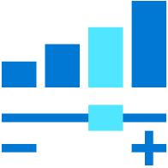
Azure Data Explorer
Ralph Kemperdick, Microsoft
Christoph Seck, KI-Group
Cloud Solution Architect
28-06-2022

Slide 2
Agenda
Intro
Features
Architectural context
Getting started with kusto
How it works
Visualize
Ingesting
Time Series & ML
Architecture Options & Costs

Slide 3
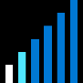
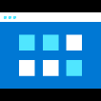

Big Data in Modern Business Environment
Free text data
Append Only
Click streams
Wikis, Blogs
Sensors/RFID/ Devices
Social Sentiment
Audio/Video
BigData
New decisions daily
Petabytes
Log files
Spatial & GPS coordinates
Data market feeds
eGov feeds
Weather
Text/image
Advertising
Mobile
Collaboration
eCommerce
Terabytes
Web 2.0
ERP/CRM
Web logs
Digital Marketing
Search Marketing
Recommendations
More decision makers
Gigabytes
Payables
Payroll
Inventory
Contacts
Deal Tracking
Sales Pipeline
Megabytes
Data Complexity: Velocity, Variety

Slide 4
Introducing Azure Data Explorer!
Any append-only stream of records
High volume
High velocity
High variance (structured, semi-structured, free-text)
Relational query model:
Filter, aggregate, join, calculated columns, …
Fully-managed
PaaS, Vanilla, Database
A big data analytics cloud platform optimized for interactive, ad-hoc queries
Purposely built
Rapid iterations to explore the data

Slide 5
Key pillars of Azure Data Explorer
INSTANT BIG DATA INSIGHTS
FULLY MANAGED PLATFORM
DEMOCRATIZING DATA ANALYTICS
PROVEN TECHNOLOGY TO SCALE FROM GBs PETABYTE
Notes:
Instant Big Data Insights ---Azure Data Explorer is a big data platform supporting near real time insights over data in petabyte scale
Fully Managed Platform - ADX is a fully managed platform for big data analytics. Embed Azure Data Explorer in SaaS applications to build multi-tenant or single tenant SaaS analytics solution for Time Series, Logs, Events, Transactions, and security data. No infrastructure management, no maintenance.
Democratizing Data Analytics - Azure Data Explorer democratizes self-service, big data analytics, with the intuitive Kusto Query Language (KQL) that provides the expressiveness and power of SQL with the simplicity of Excel
Proven Technology at Scale Petabyte - Azure Data Explorer is a distributed system with compute and storage that can scale independently, enabling analytics on gigabytes to petabytes of data.

Slide 6
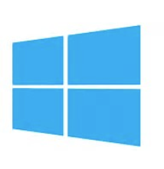
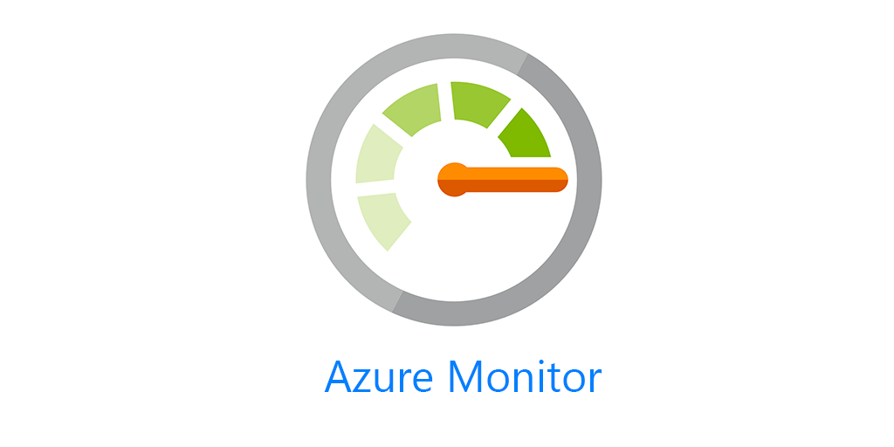












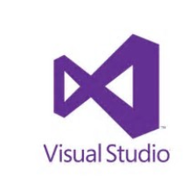
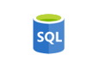


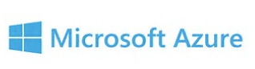
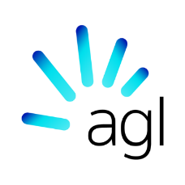




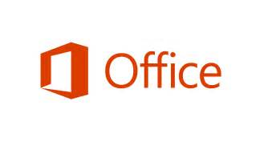


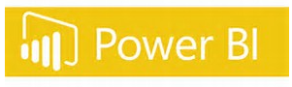

Proven Technology
In production since 2015 for internal Microsoft workload, GA since Feb 2019.
Battle tested for Microsoft internal workload
The platform for analytical solutions (SaaS)
Available as PaaS
Azure Monitor
Security Products
IoT
Gaming
#PoweredByADX
Notes:
Let me tell you about our journey with Azure Data Explorer.
To meet the growing demand of various Microsoft cloud services, Azure Data Explorer was home grown and launched back in 2015. Internally it’s called Kusto and used widely across Microsoft for telemetry analytics. It’s also the underline warm store for Azure Monitor, Application Insights, Azure Security Center, Time Series Insights, IoT Central, and more. All these services offers “a fit for purpose end to end solution”.
This is the same underline technology that we are offering to you as an Azure PaaS service.
© Microsoft Corporation

Slide 7

Microsoft’s Journey with Azure Data Explorer
65+ PB
Data ingested
daily
20+Billion
Queries per month
2+ Exabyte
Total Data Size
Azure Data Explorer A key to Microsoft's digital transformation journey
Notes:
Azure Data Explorer is a cornerstone for our operational analytics and is strategic to Microsoft. It has played a key role in Microsoft’s digital transformation journey operating at a massive scale, ingesting 35+ petabytes of telemetry data every day, 20+ billion queries per month, and 2+ Exabyte of data stored.

Slide 8
Common use cases across verticals
Retail
Financial
Oil/Gas & Energy
Security
Web Analytics, IoT Analytics
Audit Logs
Industrial IoT, Historian, Time Series, Grid analytics
Security Analytics, Threat Detection, SIEM
Healthcare
Advertising
Media Entertainment
Automotive
IoT device
Analytics
Personalized offers, campaign management
Content Delivery Network analytics, Viewer experience analytics, Live Event Analytics
Manufacturing, Connected cars, Fleet management
Central Observability (Logs, Traces, Metrics) and Time Series
Notes:
There are various Log and Time Series across the industries to:
Consolidate and correlate logs and events data across on-prem, cloud, 3rd party
Replace legacy log search solutions
Accelerate your AI Ops journey (pattern recognition, anomaly detection, forecasting, etc.)
Building IoT Analytics

Slide 9
Integration Patterns

Slide 10
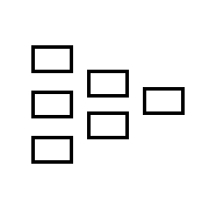

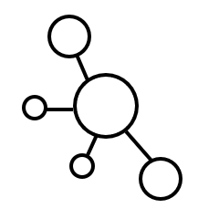
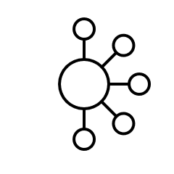
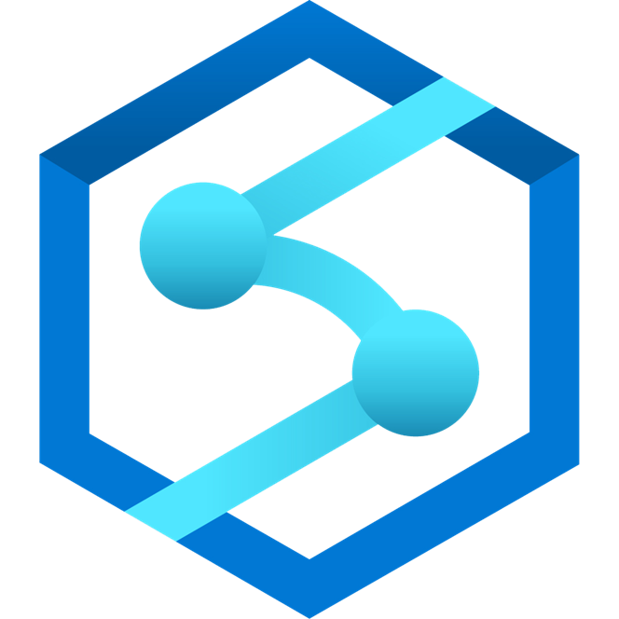
Integration: Streaming Ingestion
Land your data in ADX and then export to the data lake
Moving window of data (days to months)
Real-time, cached and indexed data for faster interactive query over billions of records
Logs (unstructured)
Streaming
Event Hub
Azure Data Explorer
Export to Data Lake
Media (unstructured)
Azure Data Lake Storage
IoT Hub
Files (unstructured)
Kafka
Business/custom apps
(structured)
Azure Data Factory
Azure Synapse Analytics
Azure Analysis Services
Power BI
Notes:
There are two typical patterns:
Streaming ingestion for low latency insights where the data directly lands into ADX, where its cached and indexed for faster query performance and optionally exported out to Azure Data Lake in parquet format ready for batch processing and integration with other Big Data and ML services.

Slide 11
Integration: Batch Ingestion
Ingest data from Data Lake or other sources in batch mode
Moving window of data (days to months)
Real-time, cached and indexed data for faster interactive query over billions of records
Logs (unstructured)
Event Hub
Azure Data Explorer
Ingest from Data Lake
Media (unstructured)
Azure Data Lake Storage
IoT Hub
Files (unstructured)
Kafka
Business/custom apps
(structured)
Azure Data Factory
Azure Synapse Analytics
Azure Analysis Services
Power BI
Notes:
You can also ingest data in batches to cache and index the data in ADX.

Slide 12
Lab 1

Slide 13
Samples, a free Cluster & the Lab
https://dataexplorer.azure.com/home
https://github.com/ralphke/Azure-Data-Explorer-Labs
Notes:
The index, make it possible to efficiently skip entire batches of records when queries are predicated on the table’s raw data.
Stored in Azure Blob, with each data shard composed of one or more blobs.
It allows multiple Compute nodes in the cluster to cache the data shard, without complex change management coordination between them.
It allows multiple Compute clusters to refer to the same data shard.
It adds robustness to the system, as there’s no complex code to “surgically modify” parts of existing storage artifacts.
It allows “travel back in time” to a previous snapshot as long as the storage artifacts of the data shard are not hard-deleted.
Azure Data Explorer uses its own proprietary format for the data shards storage artifacts, custom-built for the technology. For example, the format is built so that storage artifacts can be memory-mapped by the process querying them, and allows for data management operations that are unique to our technology, including index-only merge of data shards. There is no need to transform the data prior to querying

Slide 14
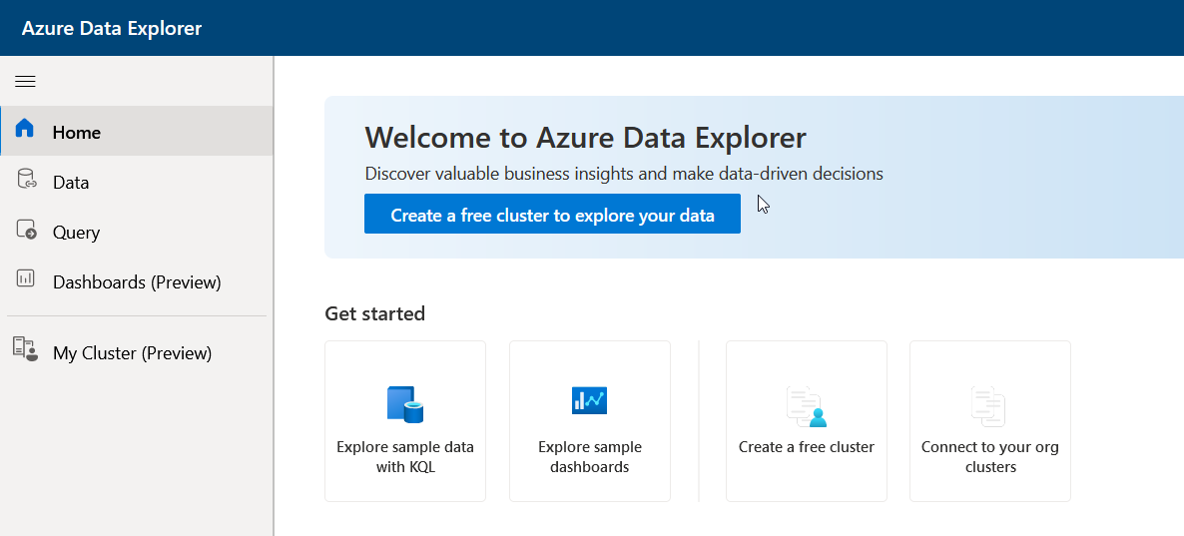
Starting at dataexplorer.azure.com …
Notes:
The index, make it possible to efficiently skip entire batches of records when queries are predicated on the table’s raw data.
Stored in Azure Blob, with each data shard composed of one or more blobs.
It allows multiple Compute nodes in the cluster to cache the data shard, without complex change management coordination between them.
It allows multiple Compute clusters to refer to the same data shard.
It adds robustness to the system, as there’s no complex code to “surgically modify” parts of existing storage artifacts.
It allows “travel back in time” to a previous snapshot as long as the storage artifacts of the data shard are not hard-deleted.
Azure Data Explorer uses its own proprietary format for the data shards storage artifacts, custom-built for the technology. For example, the format is built so that storage artifacts can be memory-mapped by the process querying them, and allows for data management operations that are unique to our technology, including index-only merge of data shards. There is no need to transform the data prior to querying

Slide 15
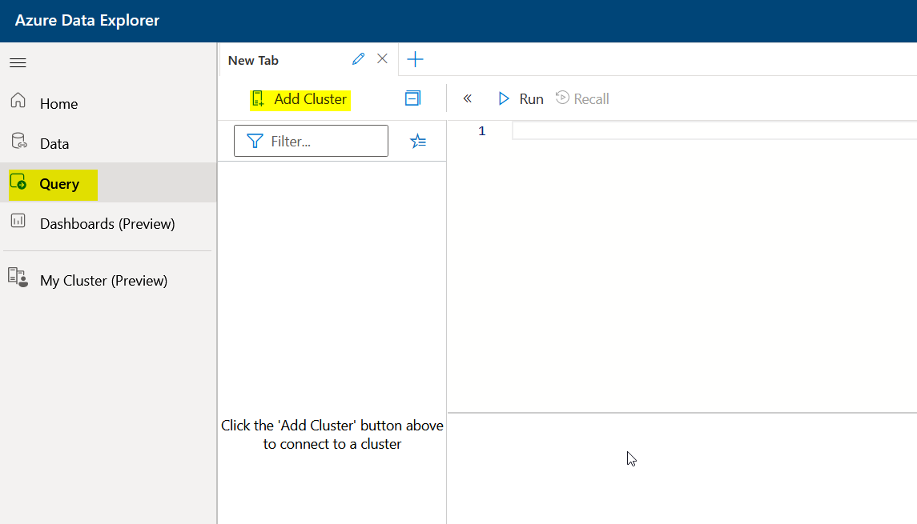
Connect to samples
Notes:
The index, make it possible to efficiently skip entire batches of records when queries are predicated on the table’s raw data.
Stored in Azure Blob, with each data shard composed of one or more blobs.
It allows multiple Compute nodes in the cluster to cache the data shard, without complex change management coordination between them.
It allows multiple Compute clusters to refer to the same data shard.
It adds robustness to the system, as there’s no complex code to “surgically modify” parts of existing storage artifacts.
It allows “travel back in time” to a previous snapshot as long as the storage artifacts of the data shard are not hard-deleted.
Azure Data Explorer uses its own proprietary format for the data shards storage artifacts, custom-built for the technology. For example, the format is built so that storage artifacts can be memory-mapped by the process querying them, and allows for data management operations that are unique to our technology, including index-only merge of data shards. There is no need to transform the data prior to querying

Slide 16
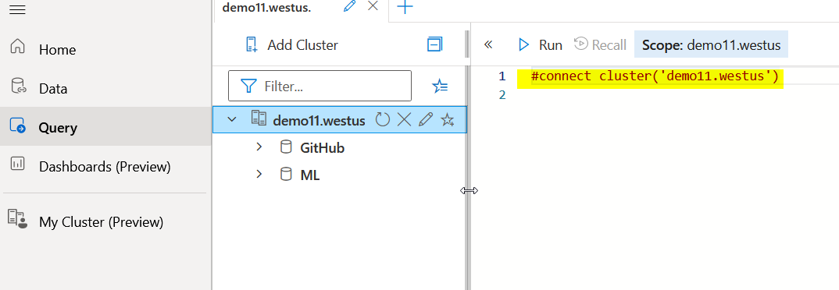
Connect to samples
Notes:
The index, make it possible to efficiently skip entire batches of records when queries are predicated on the table’s raw data.
Stored in Azure Blob, with each data shard composed of one or more blobs.
It allows multiple Compute nodes in the cluster to cache the data shard, without complex change management coordination between them.
It allows multiple Compute clusters to refer to the same data shard.
It adds robustness to the system, as there’s no complex code to “surgically modify” parts of existing storage artifacts.
It allows “travel back in time” to a previous snapshot as long as the storage artifacts of the data shard are not hard-deleted.
Azure Data Explorer uses its own proprietary format for the data shards storage artifacts, custom-built for the technology. For example, the format is built so that storage artifacts can be memory-mapped by the process querying them, and allows for data management operations that are unique to our technology, including index-only merge of data shards. There is no need to transform the data prior to querying

Slide 17
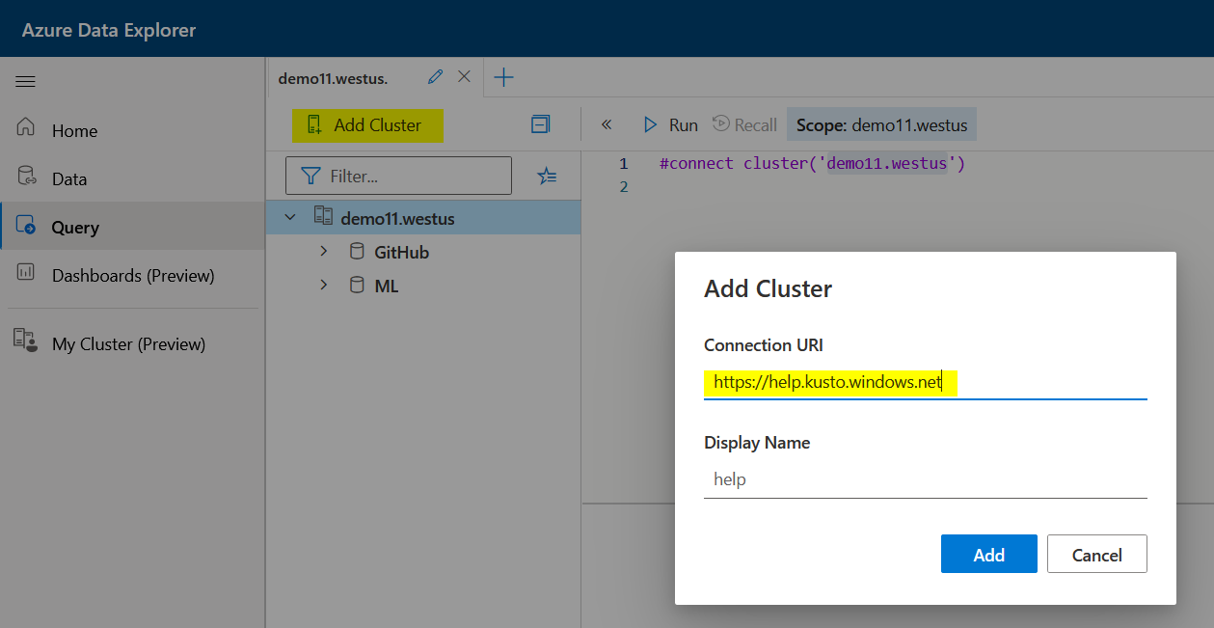
Connect to samples via UI
Notes:
The index, make it possible to efficiently skip entire batches of records when queries are predicated on the table’s raw data.
Stored in Azure Blob, with each data shard composed of one or more blobs.
It allows multiple Compute nodes in the cluster to cache the data shard, without complex change management coordination between them.
It allows multiple Compute clusters to refer to the same data shard.
It adds robustness to the system, as there’s no complex code to “surgically modify” parts of existing storage artifacts.
It allows “travel back in time” to a previous snapshot as long as the storage artifacts of the data shard are not hard-deleted.
Azure Data Explorer uses its own proprietary format for the data shards storage artifacts, custom-built for the technology. For example, the format is built so that storage artifacts can be memory-mapped by the process querying them, and allows for data management operations that are unique to our technology, including index-only merge of data shards. There is no need to transform the data prior to querying

Slide 18
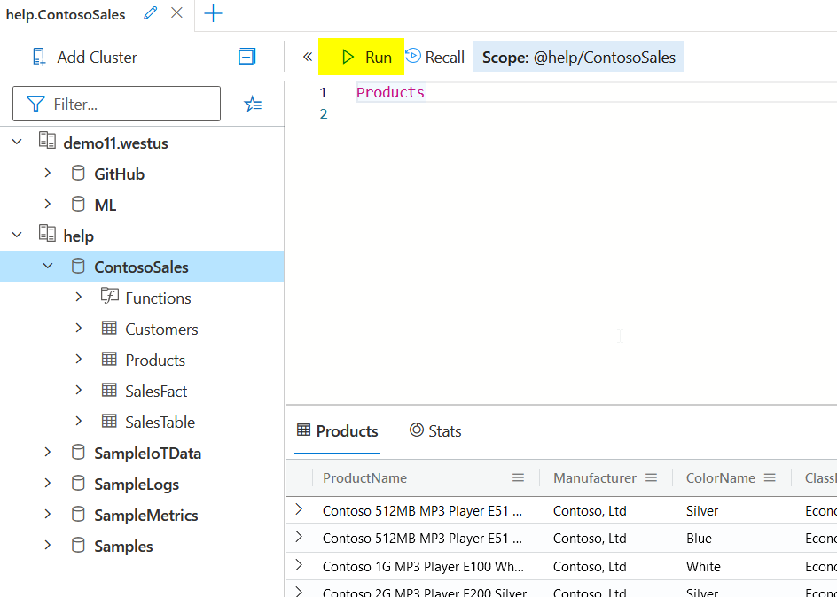
The first Query
Notes:
The index, make it possible to efficiently skip entire batches of records when queries are predicated on the table’s raw data.
Stored in Azure Blob, with each data shard composed of one or more blobs.
It allows multiple Compute nodes in the cluster to cache the data shard, without complex change management coordination between them.
It allows multiple Compute clusters to refer to the same data shard.
It adds robustness to the system, as there’s no complex code to “surgically modify” parts of existing storage artifacts.
It allows “travel back in time” to a previous snapshot as long as the storage artifacts of the data shard are not hard-deleted.
Azure Data Explorer uses its own proprietary format for the data shards storage artifacts, custom-built for the technology. For example, the format is built so that storage artifacts can be memory-mapped by the process querying them, and allows for data management operations that are unique to our technology, including index-only merge of data shards. There is no need to transform the data prior to querying

Slide 19
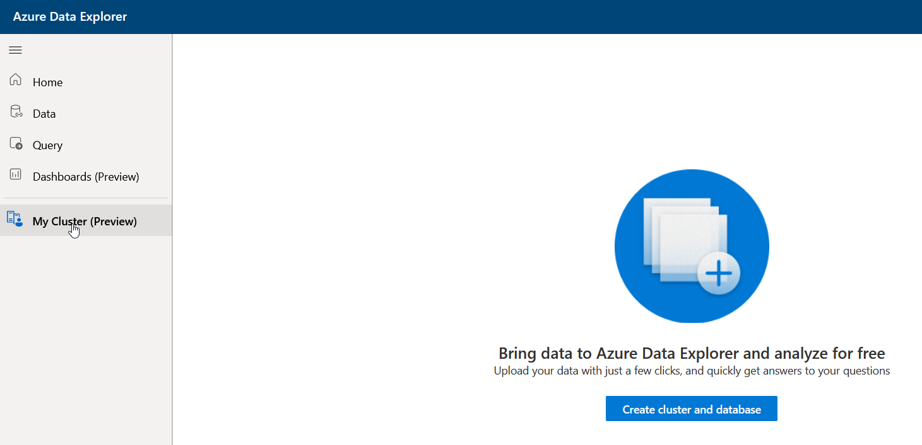
Get your own
Notes:
The index, make it possible to efficiently skip entire batches of records when queries are predicated on the table’s raw data.
Stored in Azure Blob, with each data shard composed of one or more blobs.
It allows multiple Compute nodes in the cluster to cache the data shard, without complex change management coordination between them.
It allows multiple Compute clusters to refer to the same data shard.
It adds robustness to the system, as there’s no complex code to “surgically modify” parts of existing storage artifacts.
It allows “travel back in time” to a previous snapshot as long as the storage artifacts of the data shard are not hard-deleted.
Azure Data Explorer uses its own proprietary format for the data shards storage artifacts, custom-built for the technology. For example, the format is built so that storage artifacts can be memory-mapped by the process querying them, and allows for data management operations that are unique to our technology, including index-only merge of data shards. There is no need to transform the data prior to querying

Slide 20
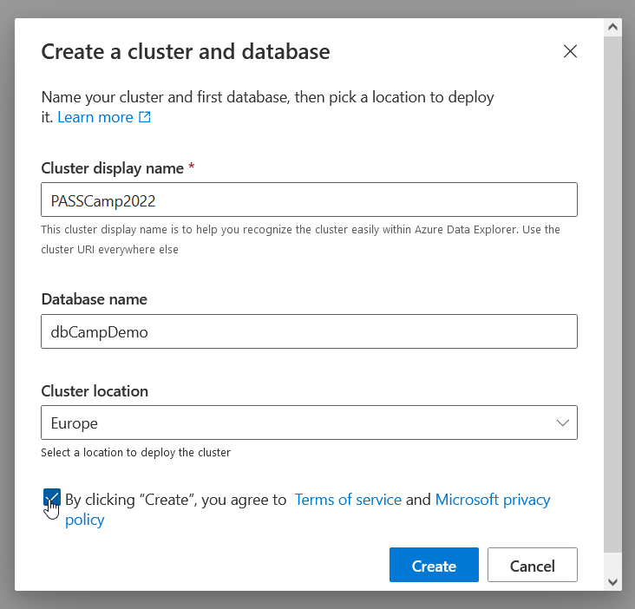
Get your own
Notes:
The index, make it possible to efficiently skip entire batches of records when queries are predicated on the table’s raw data.
Stored in Azure Blob, with each data shard composed of one or more blobs.
It allows multiple Compute nodes in the cluster to cache the data shard, without complex change management coordination between them.
It allows multiple Compute clusters to refer to the same data shard.
It adds robustness to the system, as there’s no complex code to “surgically modify” parts of existing storage artifacts.
It allows “travel back in time” to a previous snapshot as long as the storage artifacts of the data shard are not hard-deleted.
Azure Data Explorer uses its own proprietary format for the data shards storage artifacts, custom-built for the technology. For example, the format is built so that storage artifacts can be memory-mapped by the process querying them, and allows for data management operations that are unique to our technology, including index-only merge of data shards. There is no need to transform the data prior to querying

Slide 21
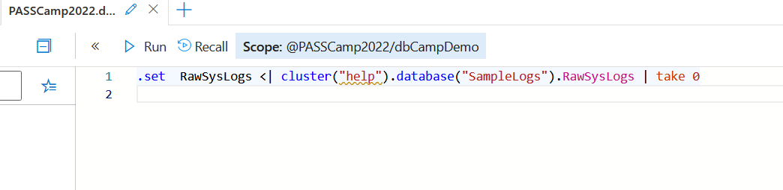
A table
Notes:
The index, make it possible to efficiently skip entire batches of records when queries are predicated on the table’s raw data.
Stored in Azure Blob, with each data shard composed of one or more blobs.
It allows multiple Compute nodes in the cluster to cache the data shard, without complex change management coordination between them.
It allows multiple Compute clusters to refer to the same data shard.
It adds robustness to the system, as there’s no complex code to “surgically modify” parts of existing storage artifacts.
It allows “travel back in time” to a previous snapshot as long as the storage artifacts of the data shard are not hard-deleted.
Azure Data Explorer uses its own proprietary format for the data shards storage artifacts, custom-built for the technology. For example, the format is built so that storage artifacts can be memory-mapped by the process querying them, and allows for data management operations that are unique to our technology, including index-only merge of data shards. There is no need to transform the data prior to querying

Slide 22
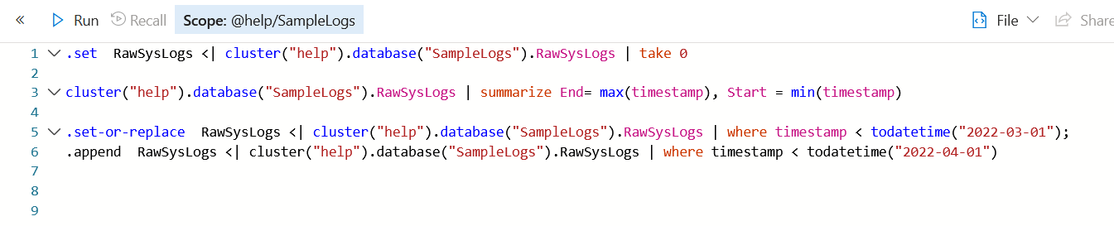
And some data
LAB 1
Notes:
The index, make it possible to efficiently skip entire batches of records when queries are predicated on the table’s raw data.
Stored in Azure Blob, with each data shard composed of one or more blobs.
It allows multiple Compute nodes in the cluster to cache the data shard, without complex change management coordination between them.
It allows multiple Compute clusters to refer to the same data shard.
It adds robustness to the system, as there’s no complex code to “surgically modify” parts of existing storage artifacts.
It allows “travel back in time” to a previous snapshot as long as the storage artifacts of the data shard are not hard-deleted.
Azure Data Explorer uses its own proprietary format for the data shards storage artifacts, custom-built for the technology. For example, the format is built so that storage artifacts can be memory-mapped by the process querying them, and allows for data management operations that are unique to our technology, including index-only merge of data shards. There is no need to transform the data prior to querying

Slide 23
Ingest Data
LAB 1
Ingest data (https://pmlabstorage18008.blob.core.windows.net/lab/StormEvents.json) into a table called “StormEvents” using OneClick ingestion
Ingest data (https://pmlabstorage18008.blob.core.windows.net/lab/Population.json) into a table called “PopulationData” using OneClick ingestion
Verify that the data has been ingested correctly
Notes:
The index, make it possible to efficiently skip entire batches of records when queries are predicated on the table’s raw data.
Stored in Azure Blob, with each data shard composed of one or more blobs.
It allows multiple Compute nodes in the cluster to cache the data shard, without complex change management coordination between them.
It allows multiple Compute clusters to refer to the same data shard.
It adds robustness to the system, as there’s no complex code to “surgically modify” parts of existing storage artifacts.
It allows “travel back in time” to a previous snapshot as long as the storage artifacts of the data shard are not hard-deleted.
Azure Data Explorer uses its own proprietary format for the data shards storage artifacts, custom-built for the technology. For example, the format is built so that storage artifacts can be memory-mapped by the process querying them, and allows for data management operations that are unique to our technology, including index-only merge of data shards. There is no need to transform the data prior to querying

Slide 24
How it works

Slide 25
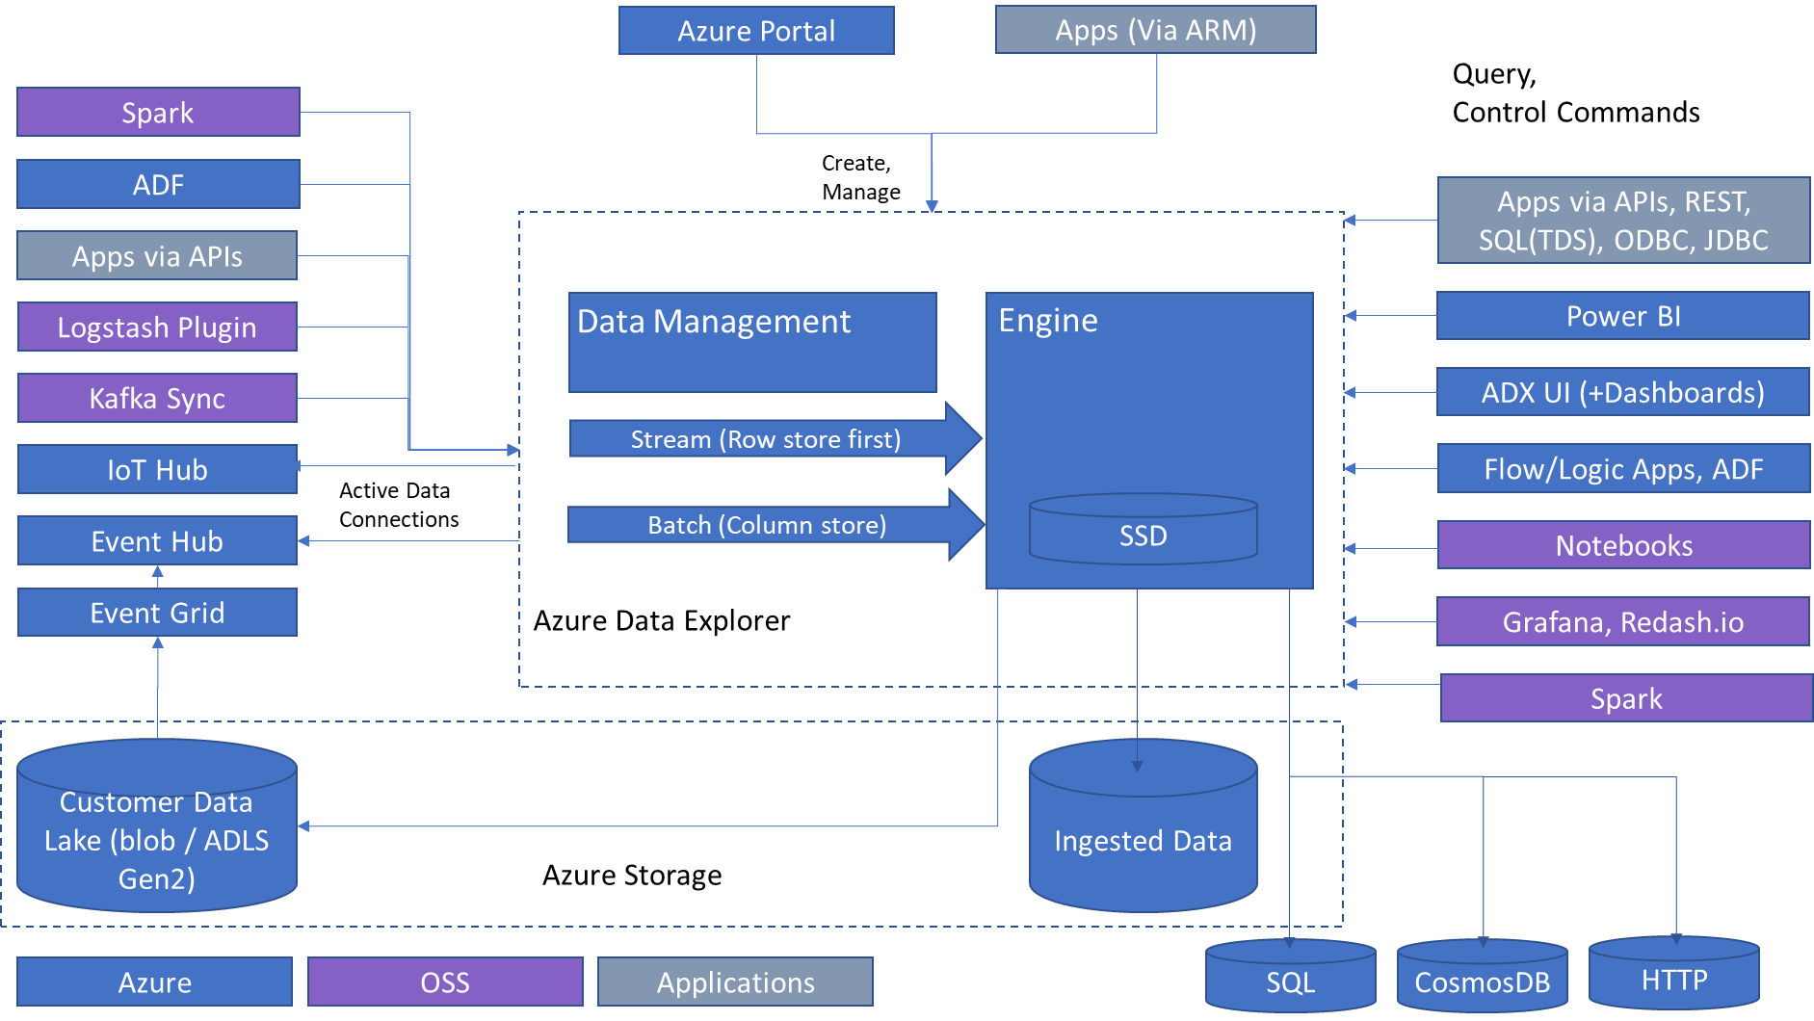
High Level Architecture
Comprehensive Strength
Analytics Query language
Simple and powerful
High performance over large data sets
Granular resource utilization Control
Metrics and time-series data
Text search and text analytics
Multi-dimensional/relational analysis
Publicly available
Data Exploration
Scale out in hardware
Scale out across geos
Rich relational query language
Full text Search
ML Extensibility
Data Ingestion and Management
Low Latency ingestion
Schema management
Compression and indexing
Retention
Hot/cold resource allocation
Cross geo queries
Notes:
OSS: Open source
Let’s look at Azure Data Explorer architecture.
It’s a PaaS service and you don’t have to maintain any infrastructure. The cluster includes two types of compute nodes: Data Management – responsible for ingestion and background jobs, it provides managed ingestion pipeline from Event Hub, IoT Hub, and Storage. Engine nodes are responsible for caching the data on local SSD’s and running distributed queries. The compute and storage are decoupled, and it can grow independently and is flexible.
On the left side, there is a list of supported data sources and on the right-hand side different integrations and tools you can use to access the data.
ADX also has external table support for exporting data to storage and querying that data.

Slide 26
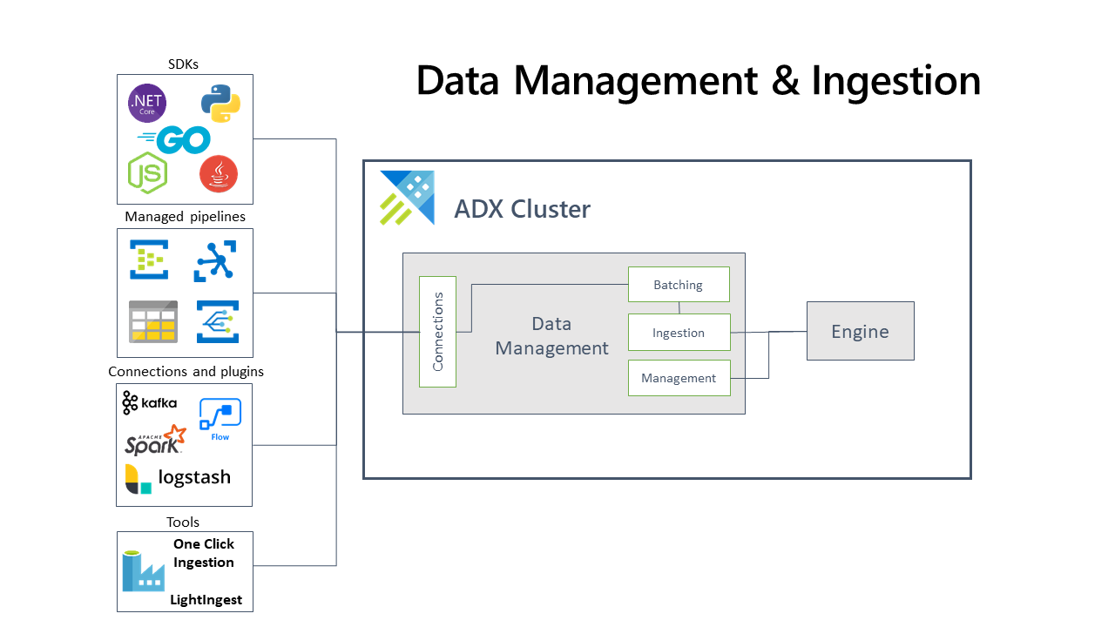
Data Management and Ingestion
SDKs
Managed pipelines
ADX Cluster
Connections
Batching
Engine
Connections & plugins
Ingestion
Data Management
Management
Tools
Notes:
Azure Data Explorer pulls data from an external source and reads requests from a pending Azure queue. Data is batched or streamed to the Data Manager. Batch data flowing to the same database and table is optimized for ingestion throughput. Azure Data Explorer validates initial data and converts data formats where necessary. Further data manipulation includes matching schema, organizing, indexing, encoding, and compressing the data. Data is persisted in storage according to the set retention policy. The Data Manager then commits the data ingest to the engine, where it's available for query.

Slide 27
ADX Cluster
Cluster
Database
Table
Database
Table
Function
Table
Table
Mat View
Colums
Columns
Columns
Columns
Notes:
By default, every field is indexed during the data ingestion. The scope of the Table level index is a single data shard

Slide 28
ADX Cluster
Node
Node
Node
Node
Node
Node
Node
Notes:
By default, every field is indexed during the data ingestion. The scope of the Table level index is a single data shard

Slide 29
Nodes in a Cluster
Admin
cluster metadata/metadata transactions
Query Head
Query requests
Orchestrate execution
Not part of ingestion
Data
Work horse
Internal RPC to other nodes
Gateway
Dispatches requests from outside

Slide 30
Ingestion Process
Data @ Admin Node
Right Table/Schema
Chose Data Node
Send data
@Data Node: Create Extension
Send info to Admin
@Admin: Update Metadata

Slide 31
Storage Highlights
Column Store
Better Compression
With sharding: Get just what’s needed
Text Indexing
Text, numeric
Special JSON (dynamic type) handling
Low granularity
(Immutable) Sharding
Parallel processing
No extra update handling
No sync overhead between nodes (Caching etc.)
Easy time travel
Notes:
The index, make it possible to efficiently skip entire batches of records when queries are predicated on the table’s raw data.
Stored in Azure Blob, with each data shard composed of one or more blobs.
It allows multiple Compute nodes in the cluster to cache the data shard, without complex change management coordination between them.
It allows multiple Compute clusters to refer to the same data shard.
It adds robustness to the system, as there’s no complex code to “surgically modify” parts of existing storage artifacts.
It allows “travel back in time” to a previous snapshot as long as the storage artifacts of the data shard are not hard-deleted.
Azure Data Explorer uses its own proprietary format for the data shards storage artifacts, custom-built for the technology. For example, the format is built so that storage artifacts can be memory-mapped by the process querying them, and allows for data management operations that are unique to our technology, including index-only merge of data shards. There is no need to transform the data prior to querying

Slide 32
ADX Table details
Extend 0 data
Extend 1 data
Try:
.show table RawSysLogs
.show table RawSysLogs details
Extend n data
Extend Directory
Column 0 Index
Column 1 Index
Meta data
Column … Index
Column m Index
Notes:
Extent directory is an index of table extents and index reference, order by ingesting time. Column Index is on Extend Level
Table Metadata table name, folder name, # of extents etc. -> .show table
`
Filter on non DateTime or DateTime without ingestion relation: => scan all the tables extent indexes

Slide 33
ADX Extend details
Meta data
Column 0:
…
Column n:
Block
Block
Column Indexes
Block
Block
Block
Block
Try:
.show table RawSysLogs extents
Notes:
Kusto Index
Inside of the extent, the leaf of column index points to data blocks, unlike the table level index, its leaf point to extent location.
String column index: inverted term index as a B-tree. This kind of index grants Kusto a powerful capability of text processing(Similar to ElasticSearch). The “contains” operator is way faster than “like” in T-SQL.
Numeric column (include DateTime and TimeSpan) index: range-based forward index. Dynamic column index: inverted term index as a B-tree, during data ingestion, the engine will enumerate all elements within the dynamic value and forward them to the index builder.

Slide 34
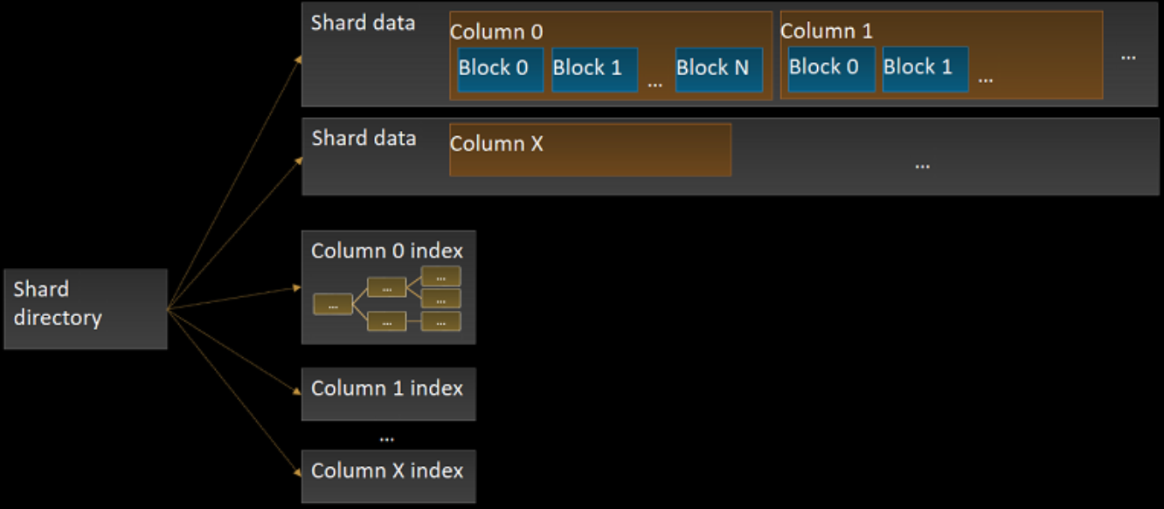
Shard details

Slide 35
Test and explain

Slide 36
Test and explain
Compare by „Data scanned“
TransformedSysLogs | summarize tr_count = count() by bin(timestamp, 1d)| where timestamp >= todatetime("2022-05-01");

Slide 37
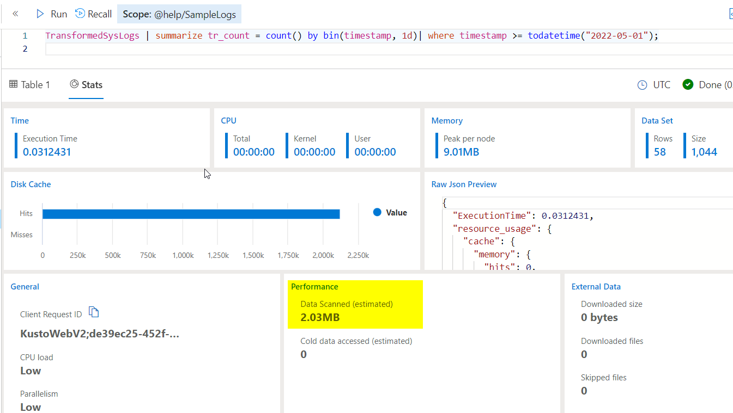
Test and explain

Slide 38
Test and explain
Compare by „Data scanned“
TransformedSysLogs | summarize tr_count = count() by bin(timestamp, 1d)| where timestamp >= todatetime("2022-05-01");

Slide 39
Test and explain
Compare by „Data scanned“
TransformedSysLogs | summarize tr_count = count() by bin(timestamp, 1d)| where timestamp >= todatetime("2022-05-01");
TransformedSysLogs | where timestamp >= todatetime("2022-05-01") | summarize tr_count = count() by bin(timestamp, 1d)

Slide 40
Test and explain
Compare by „Data scanned“
TransformedSysLogs | summarize tr_count = count() by bin(timestamp, 1d)| where timestamp >= todatetime("2022-05-01");
TransformedSysLogs | where timestamp >= todatetime("2022-05-01") | summarize tr_count = count() by bin(timestamp, 1d)
Versus
TransformedSysLogs | summarize tr_count = count() by facility| where facility == "cron";

Slide 41
Test and explain
LAB Test and Explain
Compare by „Data scanned“
TransformedSysLogs | summarize tr_count = count() by bin(timestamp, 1d)| where timestamp >= todatetime("2022-05-01");
TransformedSysLogs | where timestamp >= todatetime("2022-05-01") | summarize tr_count = count() by bin(timestamp, 1d)
Versus
TransformedSysLogs | summarize tr_count = count() by facility| where facility == "cron";
TransformedSysLogs | where facility == "cron" | summarize tr_count = count() by facility

Slide 42
Visualize

Slide 43
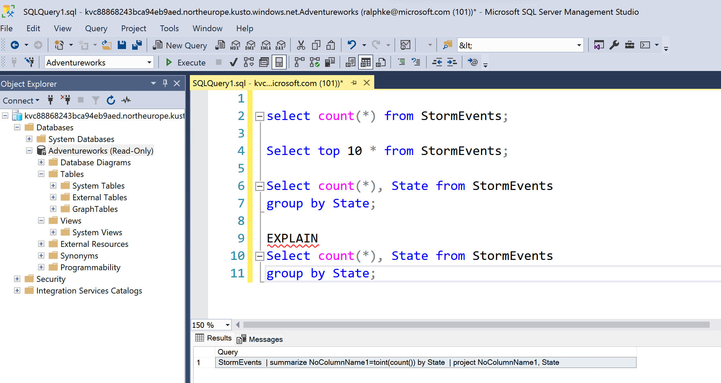
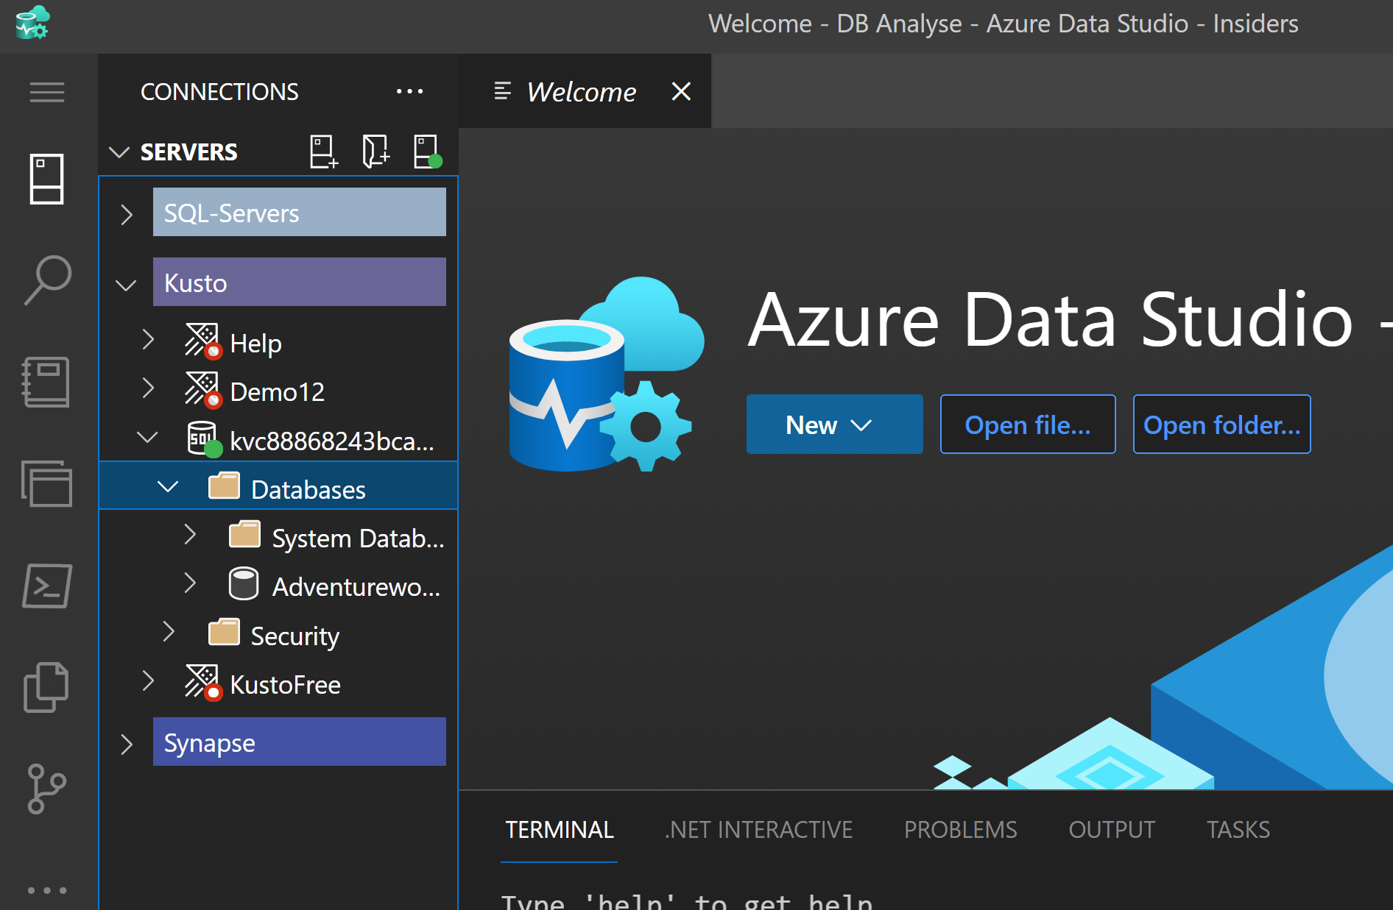
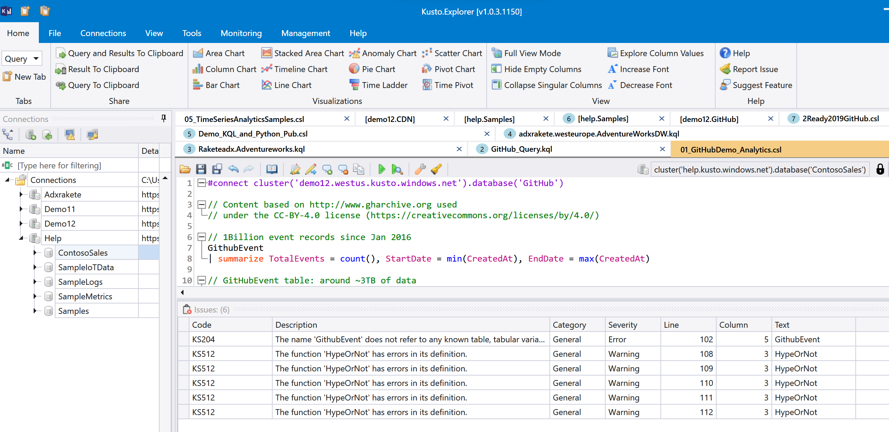
Getting started
Tools & Connectivity
SSMS
Download SQL Server Management Studio (SSMS) - SQL Server Management Studio (SSMS) | Microsoft Docs
Azure Data Studio
Download and install Azure Data Studio - Azure Data Studio | Microsoft Docs
Kusto Explorer
Kusto.Explorer installation and user interface | Microsoft Docs

Slide 44
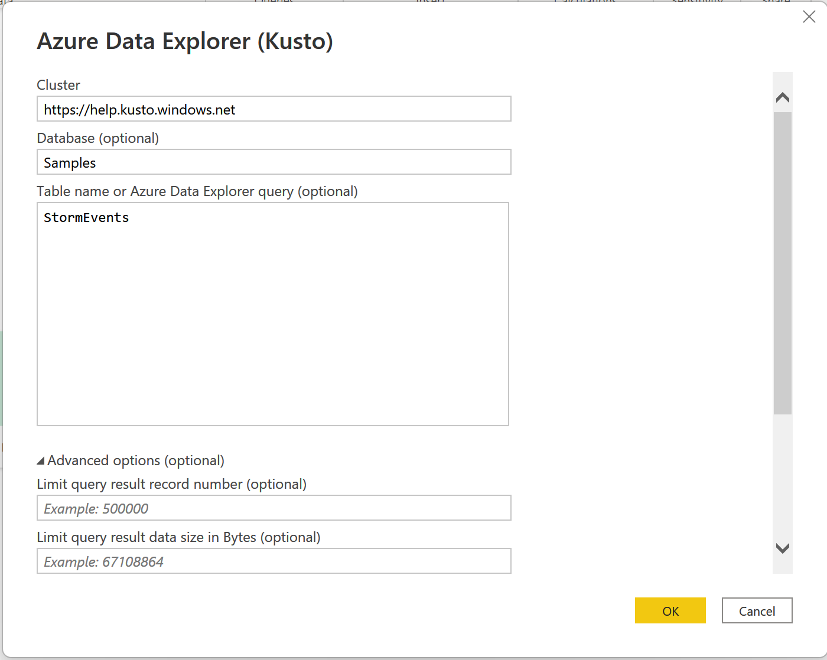
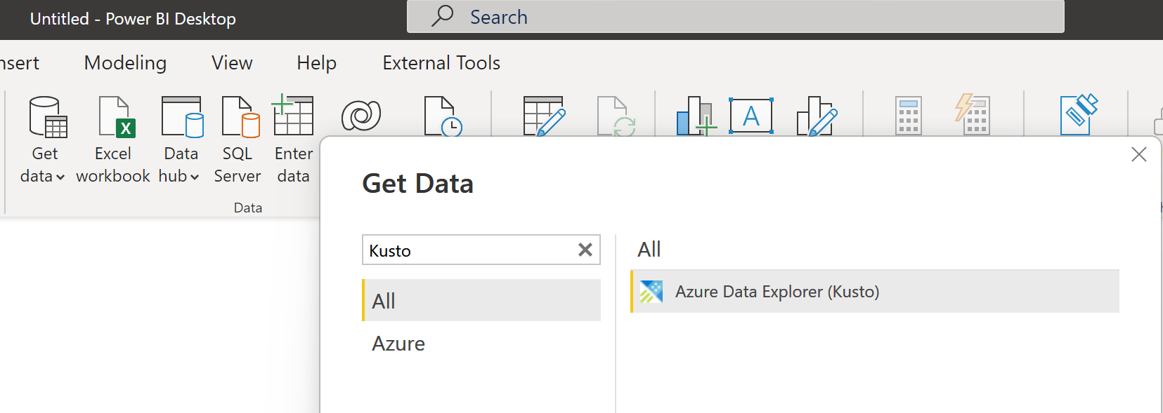
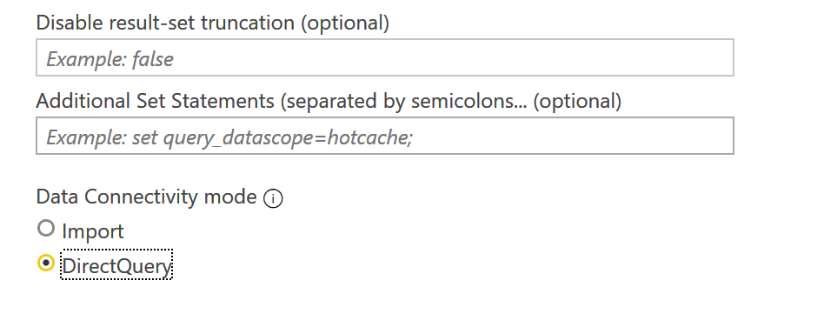
Kusto & Power BI
Connect to ADX natively

Slide 45
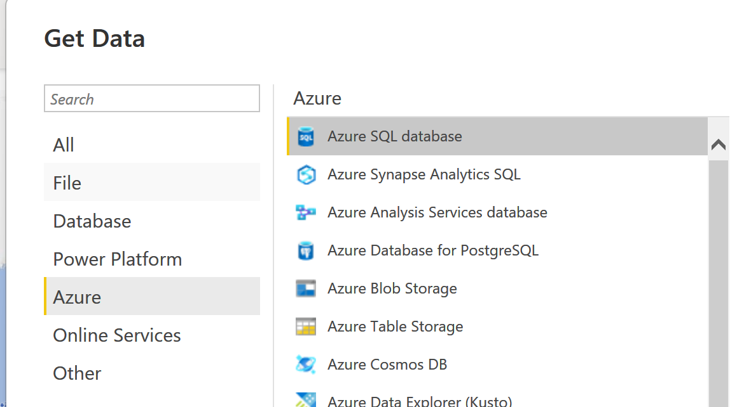
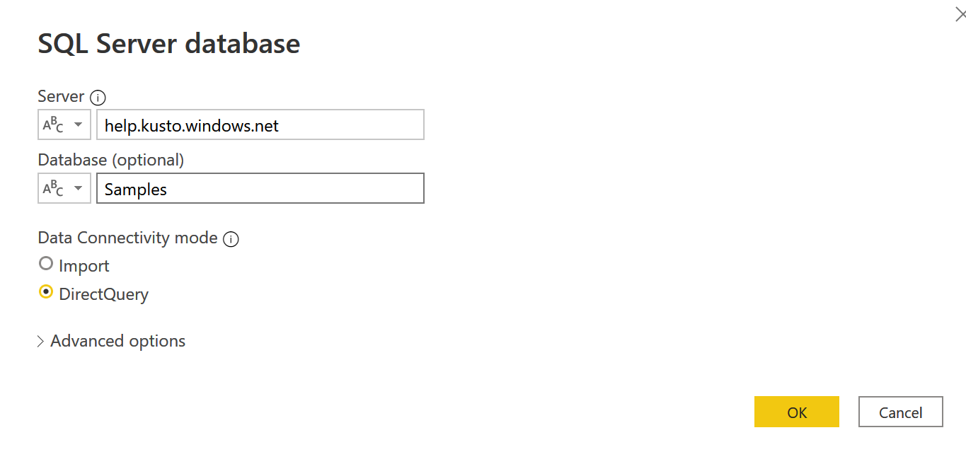
Kusto & Power BI Exkurs (SQL)
Connect to ADX via SQL

Slide 46
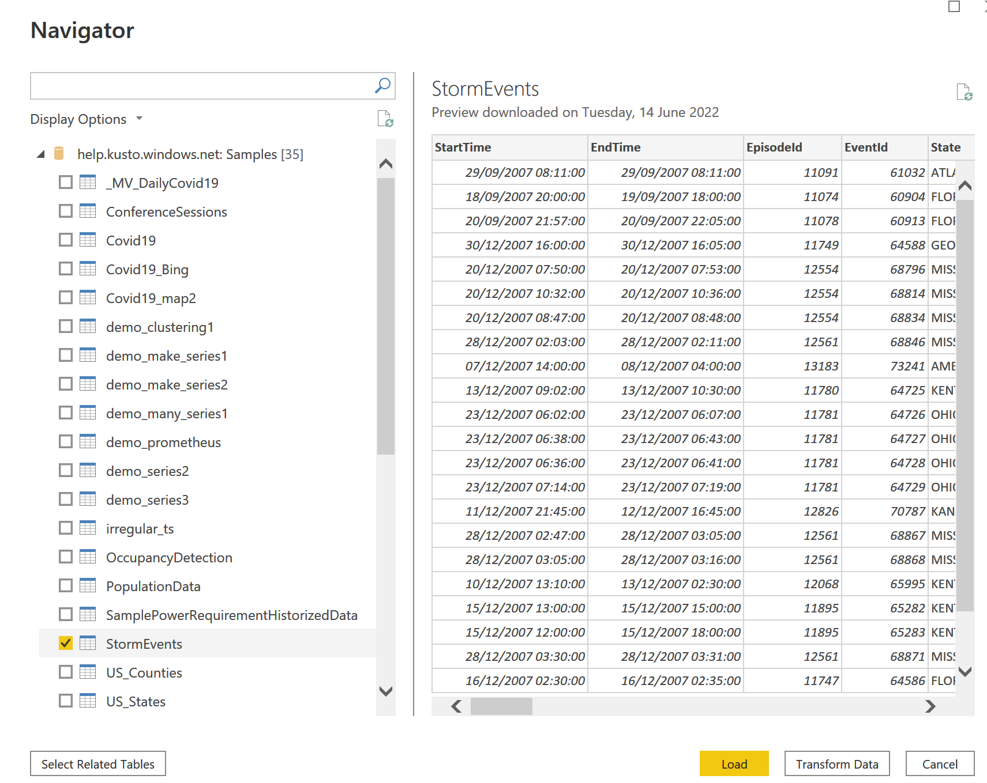
Kusto & Power BI Exkurs (SQL)
Connect to ADX via SQL

Slide 47
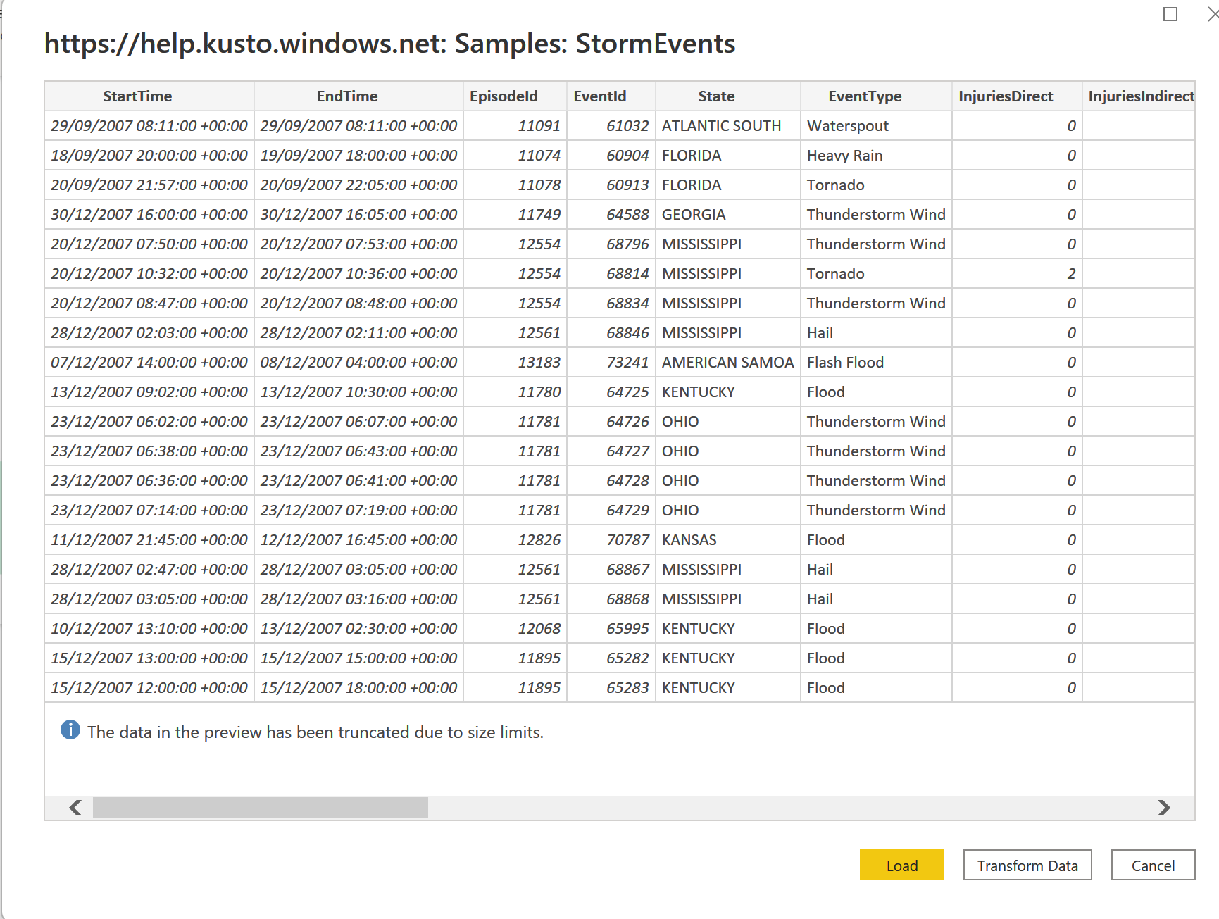
Kusto & Power BI
Select Tables and Functions

Slide 48
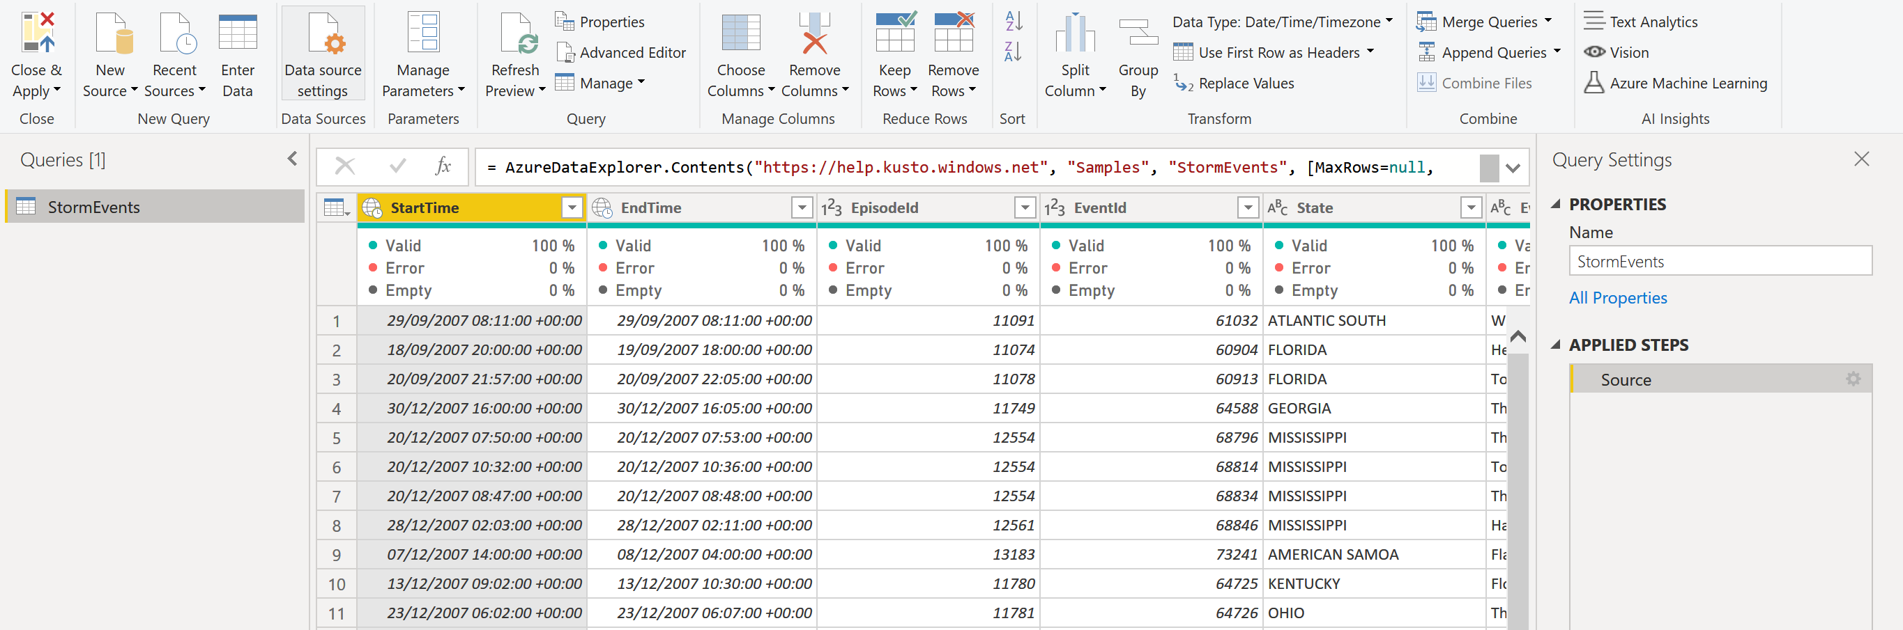
Kusto & Power BI
Transform Data

Slide 49
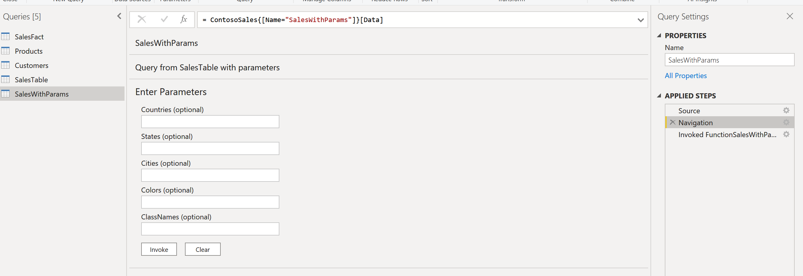
Kusto & Power BI
Invoke Funktions via M

Slide 50
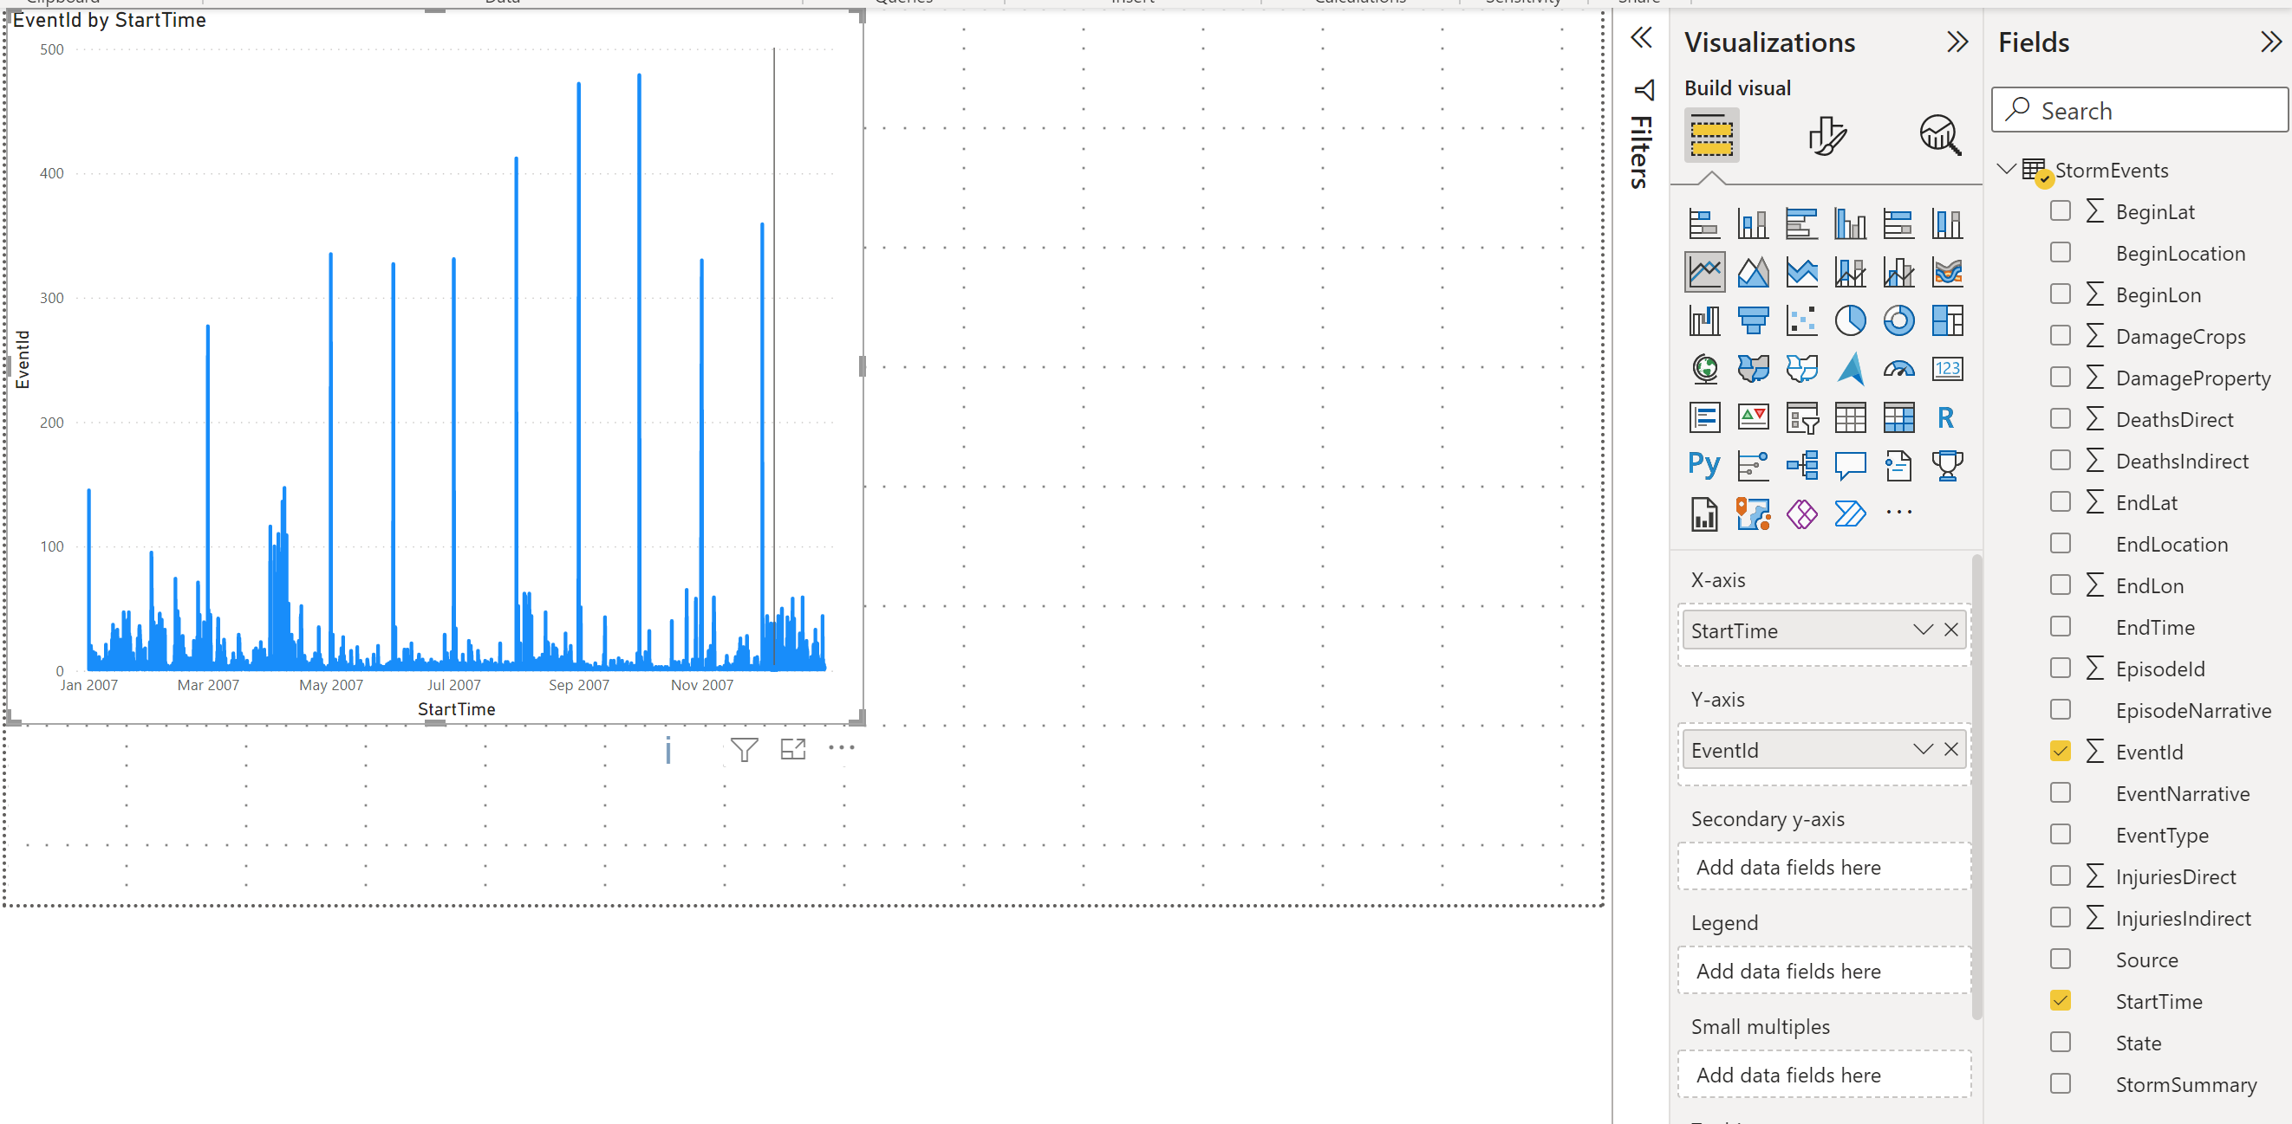
Create a Power BI report
Create a line chart with the total number of events, by putting “Start Time” in the Axis box (not in Date Hierarchy mode) and EventId in the Values box.

Slide 51
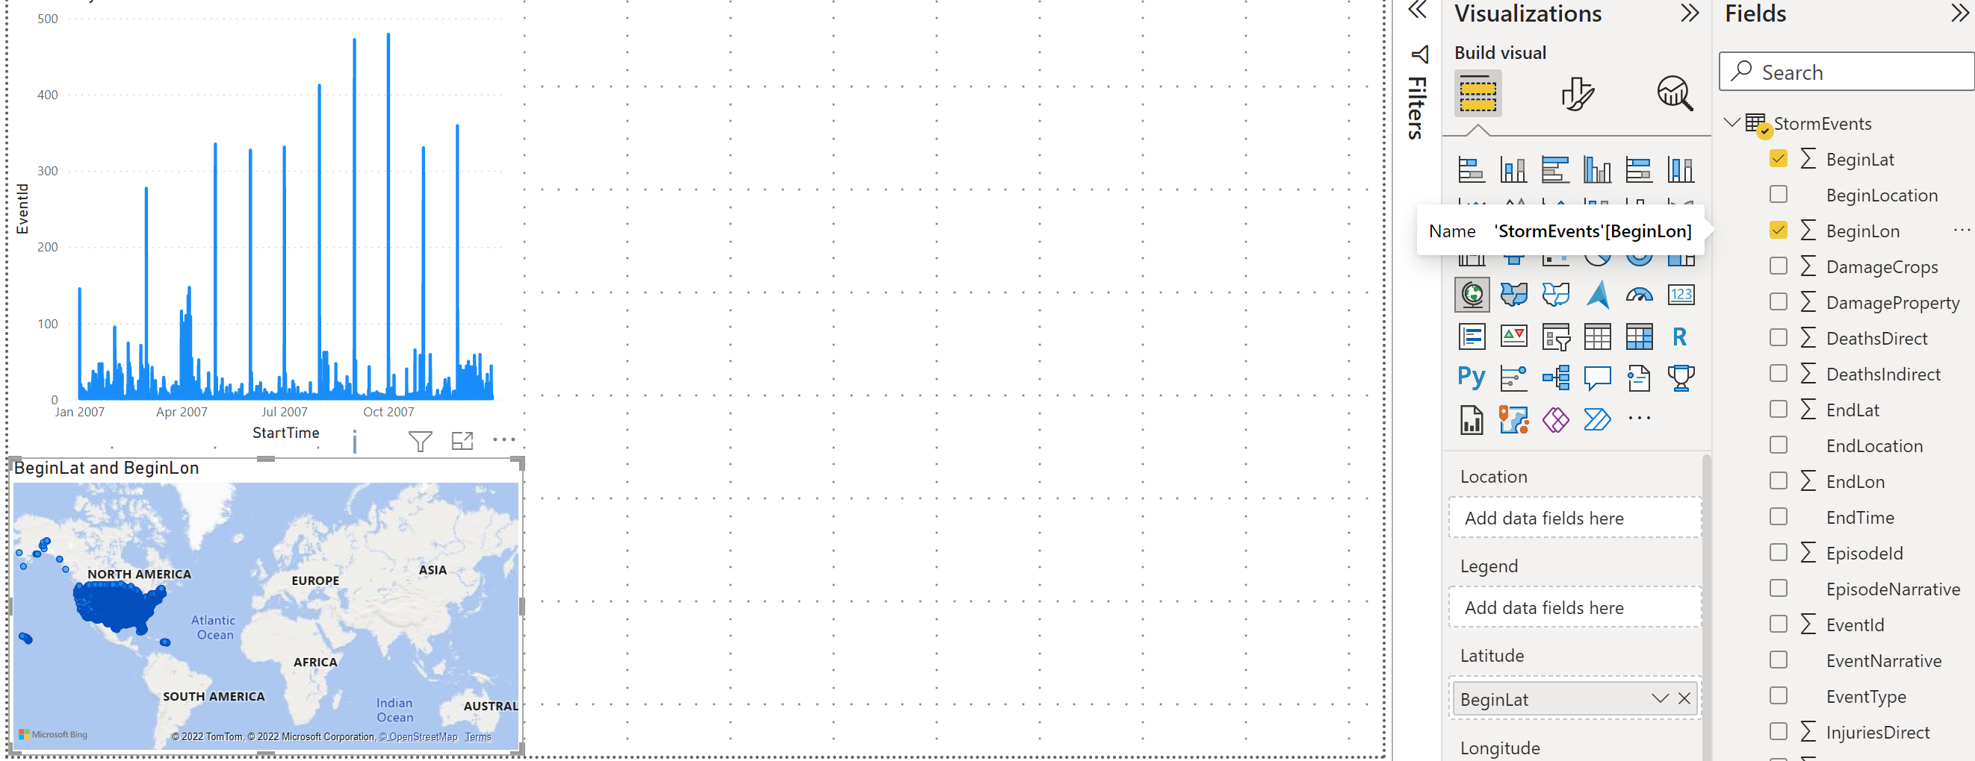
Create a Power BI report
Add a Map tile by putting “BeginLat” in the Latitude box and putting “BeginLon” in the Longitude box.

Slide 52
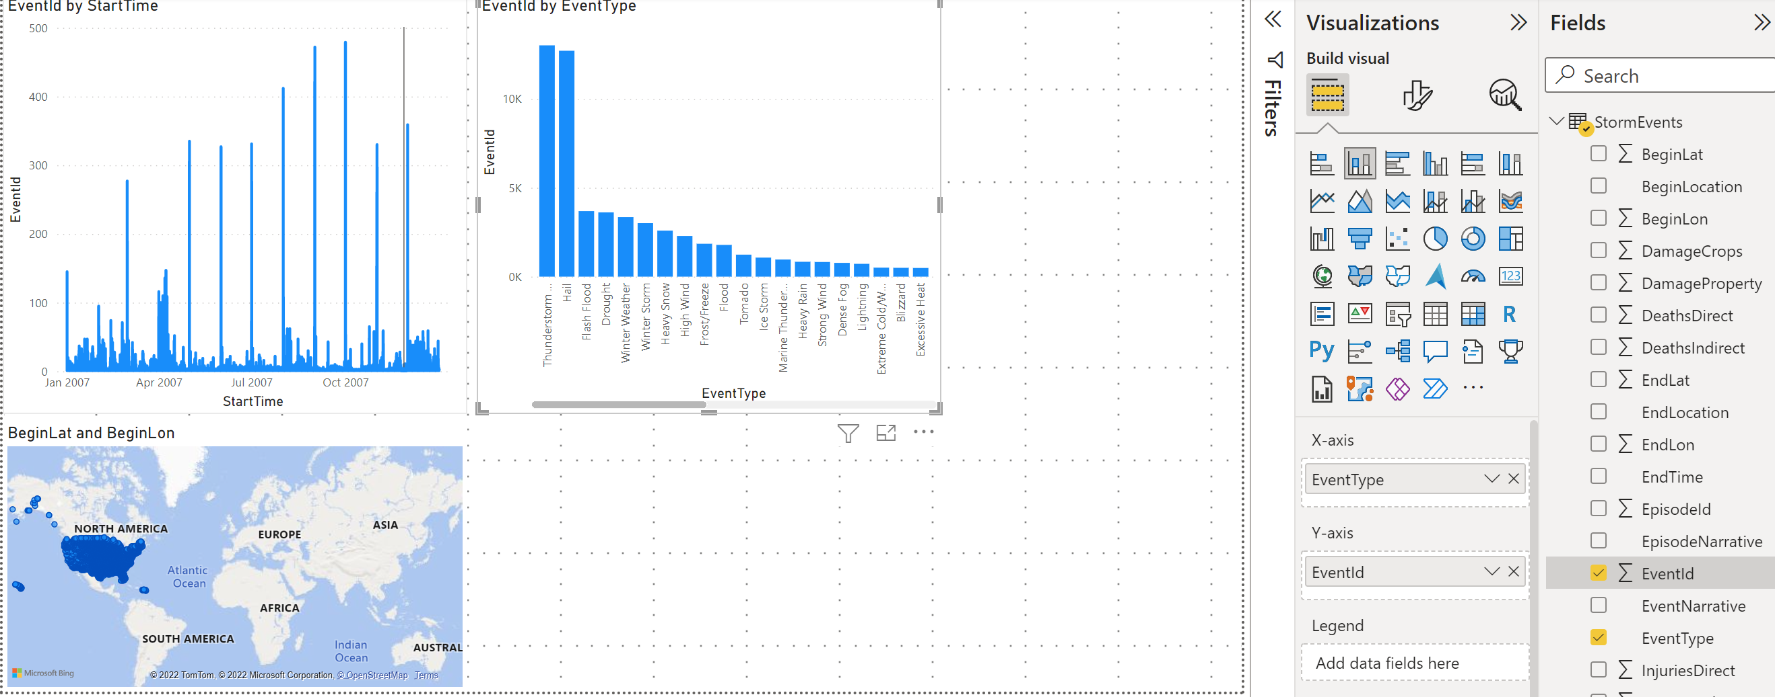
Create a Power BI report
Create a Clustered column chart by putting “Event Type” in the Axis box and (count) “Event Id” in the value box.

Slide 53
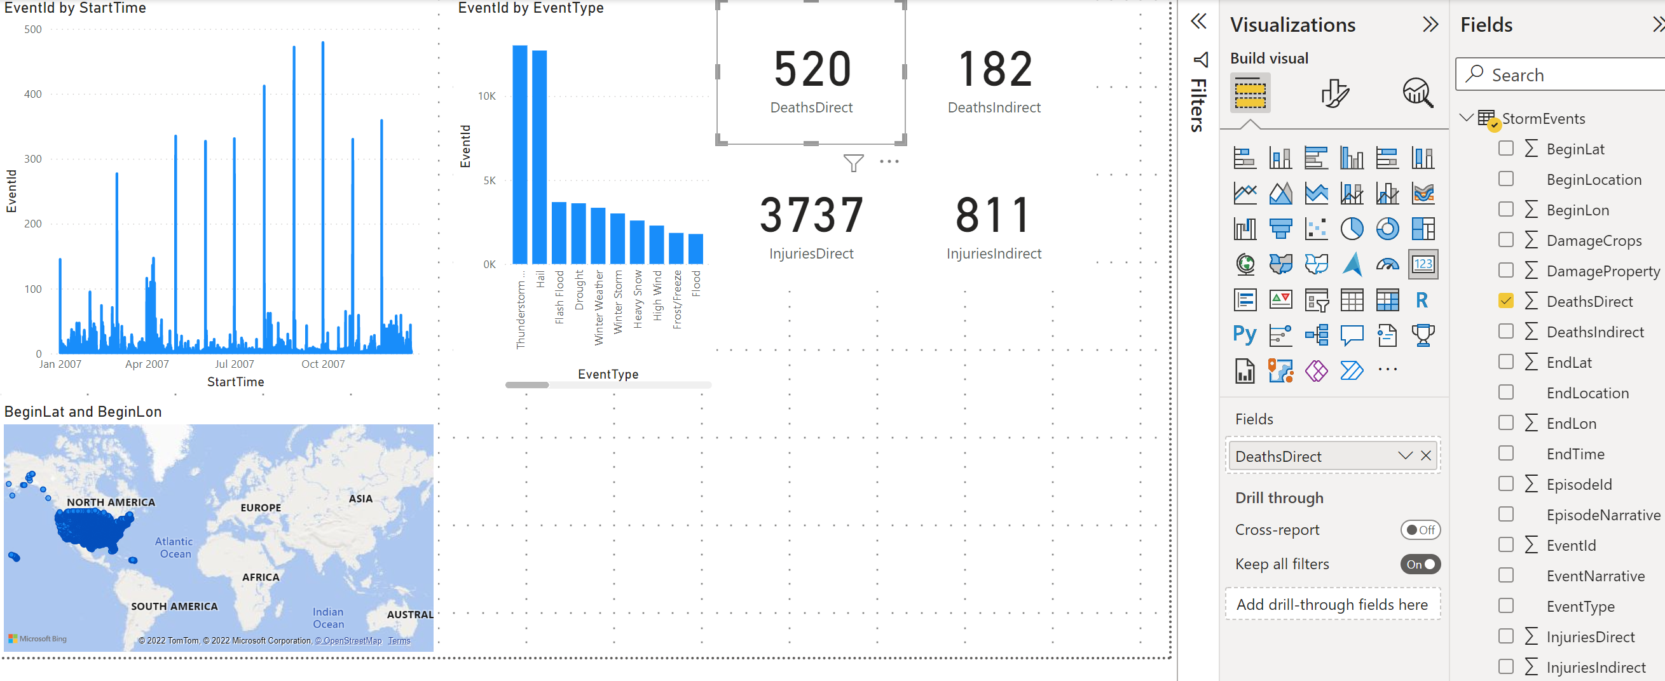
Create a Power BI report
Create 4 separate card tiles with “DeathDirect”, “DeathIndirect”, “InjuriesDirect” and “InjuriesIndirect in the Fields box.

Slide 54
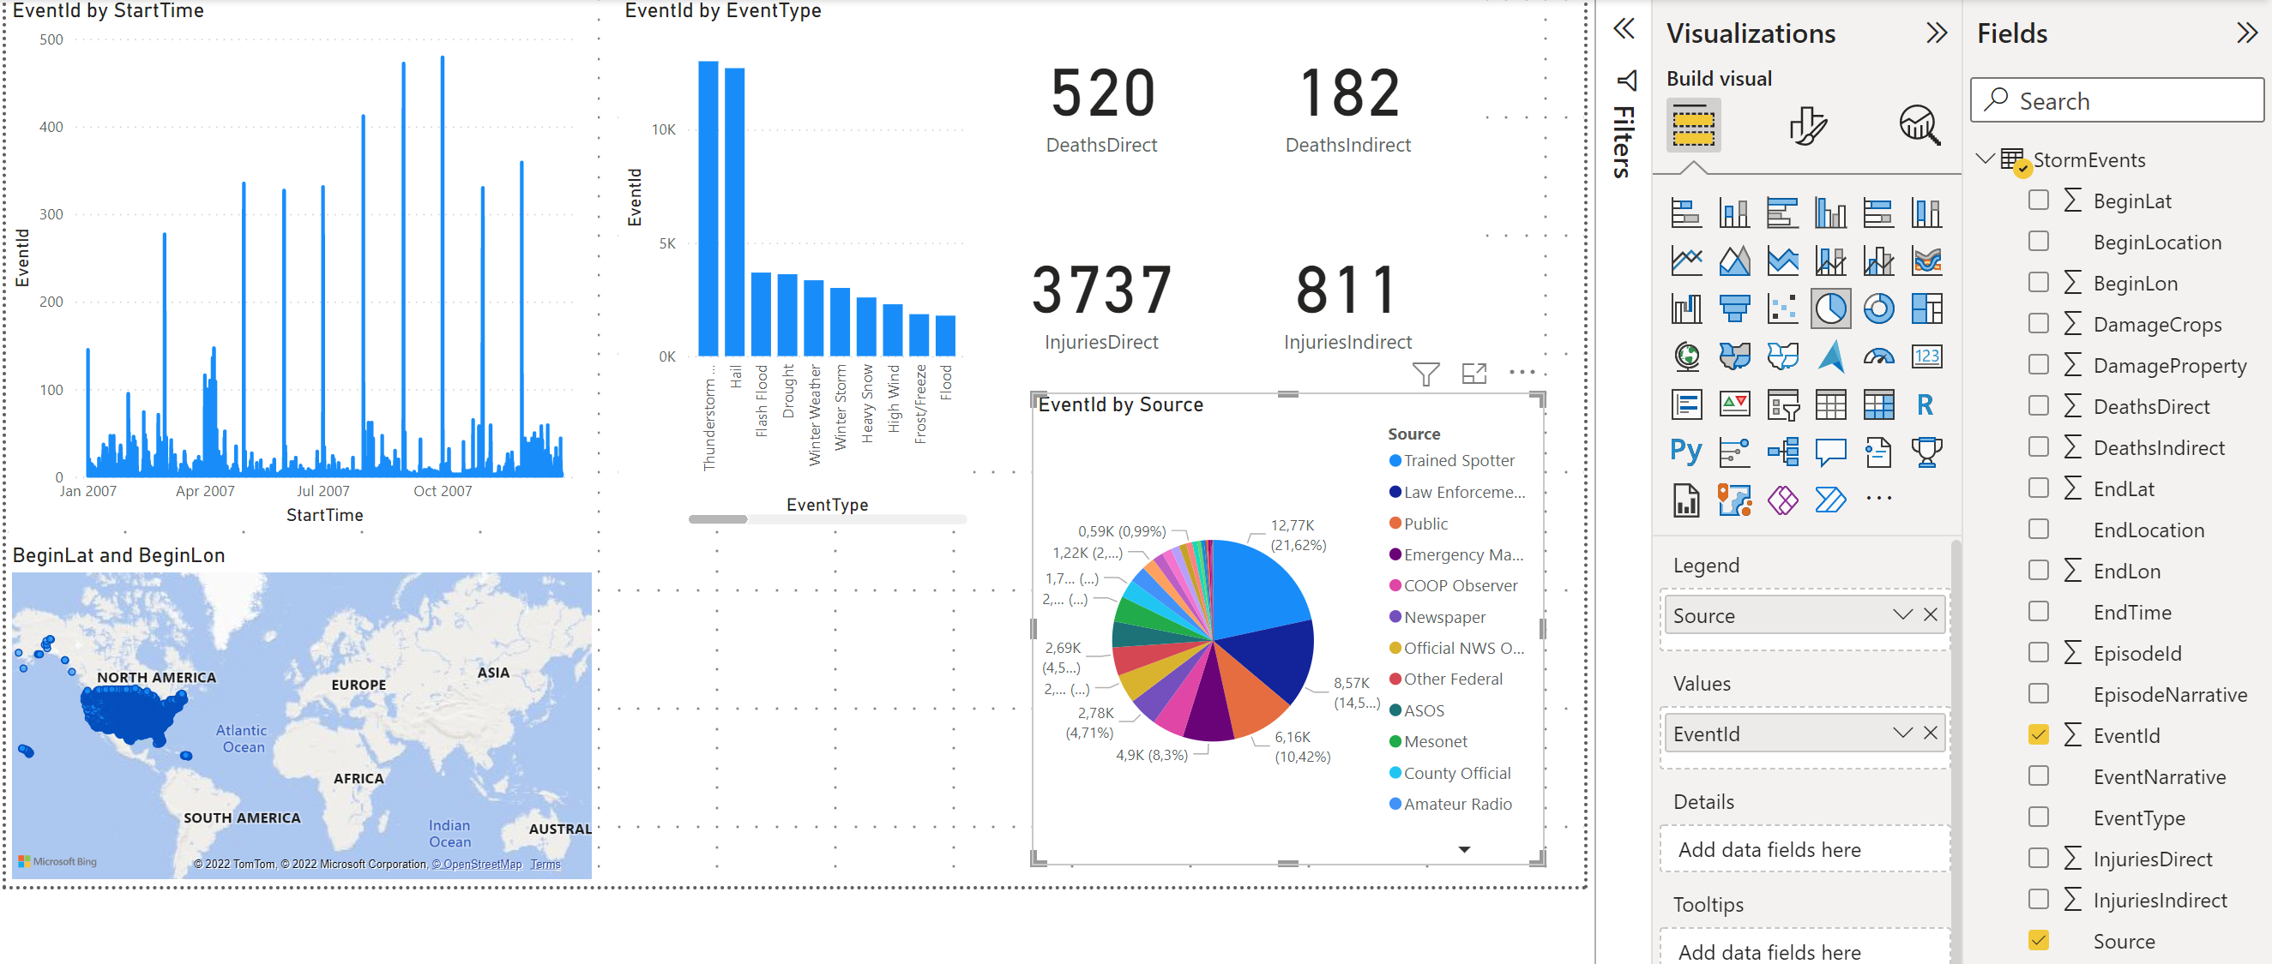
Create a Power BI report
Create a pie chart of reporting sources by putting the “Source” in the legend box and putting the (count) “EventId” in the values box.

Slide 55
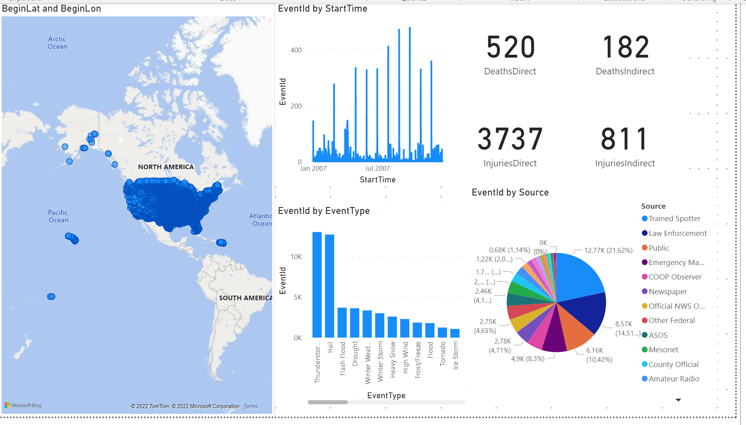
Create a Power BI report
Now arrange the tiles on the canvas and you’re ready to slice and dice.

Slide 56
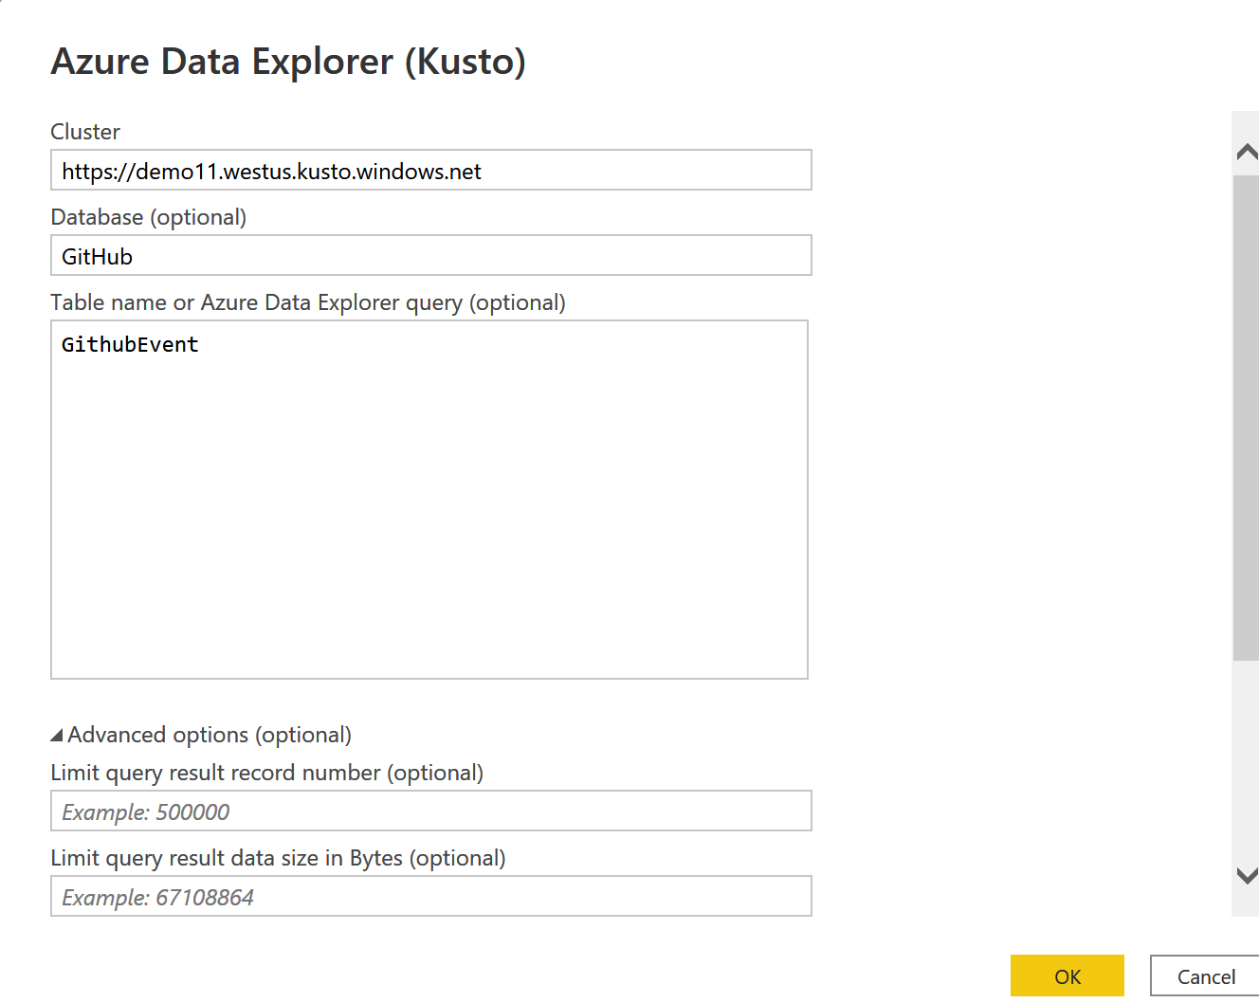
Kusto & Power BI
Connect to ADX natively

Slide 57
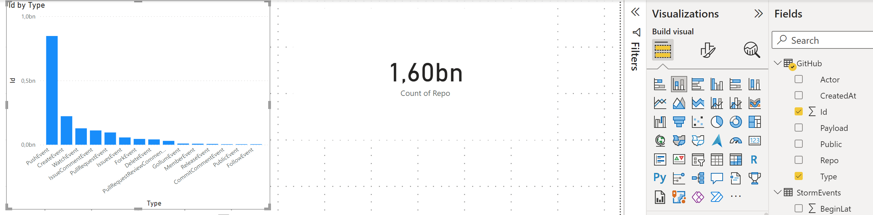
Kusto & Power BI
Interactivly Query big Data

Slide 58
Ingestion Variants

Slide 59
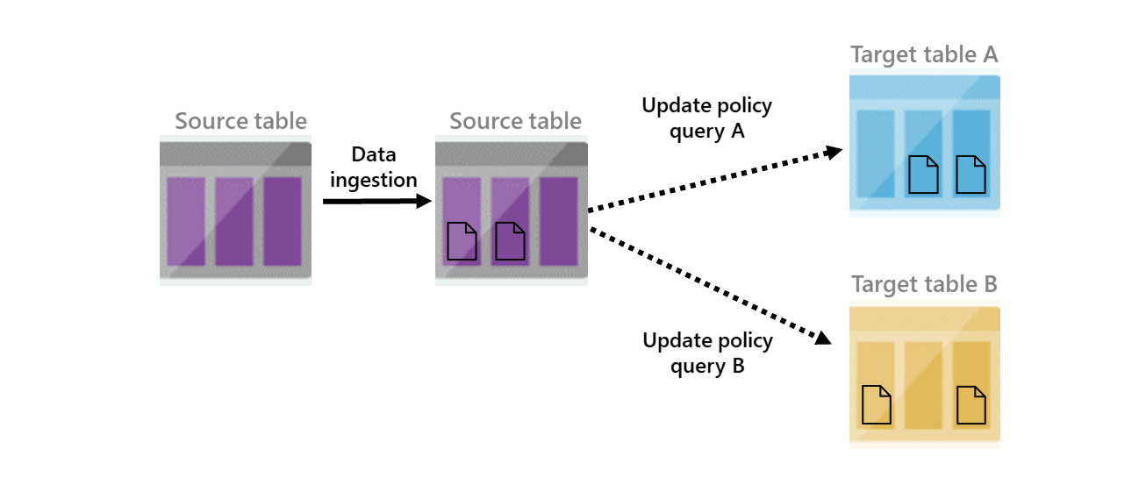
Doing the ETL
LAB ETL
Update policies allow updates to tables based on appends to source tables:
In combination with functions complex logic is possible.

Slide 60
ADX for Data Scientists

Slide 61
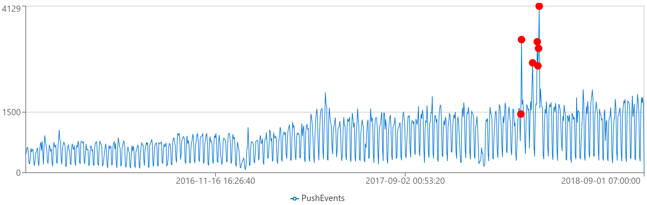

Time Series Analysis
Lab Series
T | make-series operator for creating set of (time) series
Large family of functions can be applied on set of time series:
Element-wise operations
Filtering (signal processing)
Statistics
Regressions
Seasonality detection/validation
Anomaly Detection
Forecasting
mv-apply operator
Series functions are optimized for bulks of time series
Notes:
mv-apply: Applies a subquery to each record, and returns the union of the results of all subqueries.
Sample:
T | mv-apply Metric to typeof(real) on
(
top 2 by Metric desc
)

Slide 62
Agenda
Time Series Analysis for Anomaly Detection, Forecasting
Clustering plugins for Diagnosis of Anomalies & RCA
SCAN operator for Process Mining and Sequence Analysis
KQL extensibility with inline Python/R
Connectivity with Python, R, Jupyter/Azure Notebooks, Spark

Slide 63
Machine Learning Plugins
Demo
Data Mining on multiple dimensions for diagnosis, RCA and more
autocluster: clustering a single records set
basket: same, using apriori algorithm
diffpatterns: clustering differences between two records sets
diffpatterns_text: tokenize text column and run diffpatterns

Slide 64
Process Mining by the SCAN operator
Demo
The user defines a process model composed of sequential states and transition rules from the first to the last state
The operator scans the data and extracts the instances (each one is an events sequence) conforming to that process model
Can be used for
Process Mining
User analytics, funnel analysis
Recursive calculations
Additional temporal analytics scenarios

Slide 65
python plugin: KQL extensibility with inline Python
Demo
Python engine run on secure local containers on the same Kusto compute nodes
Image is based on Anaconda 5.2.0 + popular packages (tensorflow, keras, torch and more)
Execution on single node (default) or distributed processing
Ability to install custom packages
Support for scoring with big ML models
Editing & Debugging with VS Code (client-side integration)

Slide 66
ML Connectivity
Demo
Jupyter/Azure Notebooks with KqlMagic extension
Connect multiple clusters (Kusto, Log Analytics, App Insights)
Create rich interactive notebook with Kusto and Python
Use out-of-the-box integration with Python visualization libraries

Slide 67
ML Connectivity
Python & R Client SDKs
Access data from Kusto using Python or R libraries
Spark connector
Read data or write data to Kusto using Scala and PySpark
Parquet support
Ingest parquet files from Blob/Data Lake
Export data to Blob/Data Lake as parquet files (with partitioning support)
External tables
Query parquet files from data lake as external

Slide 68
ADX “other” Topics

Slide 69


Azure Data Share - Data Sharing
Share data within the company
Load balancing
Ring fencing
Data-as-a-service
Chargeback
Share data with partners
Data sharing in near-real-time
In-Place Data Sharing
No data pipeline to maintain
Near-real-time updates
Share data with customers
Data sharing in near-real-time
Extend your business model
Notes:
Data Share integration enables sharing data:
Within the company
Across companies – tenants
Optimize my business
Typical Use Cases
Data providers can use this integration to share their data with their customers in a simple and secure way. Example, a weather forecast provider can share their data in near-real-time with their customer without having them to maintain the data pipeline. As the data is updated on the leader cluster, the change will appear on the follower cluster in few seconds or minutes depending the data volume and metadata.
Organizations can share their data with partners for collaboration and data exchange. For example, a retail company sharing the data with their suppliers.
Share data within the company or provide data-as-a-service. Many organizations would like to share the data within the company and have individual teams accountable for their usage and cost. With Azure Data Explorer, every team could have their cluster with their choice of configuration and sharing the same data from one leader cluster.

Slide 70






Pricing – Flexible Cost
Reserved resources cost model
Dedicated capacity
Reserved instance pricing available
Advantages of this model
Freely explore your data - not bound by cost per query
Predictable cost
Decoupled storage and compute
Easy to switch between SKUs after provisioning
Ability to Start/Stop the compute
Four main components
Compute Hourly billing
Storage & Transactions Used for persistent store, compressed data (typical 6x compression)
Network
Markup/IP Cost of using the PaaS Service – hourly billing based on the compute usage
http://aka.ms/adx.cost
Wide range of options
CPU optimized and Storage optimized SKUs Dev/Test SKU under $200/month PROD SKUs starting around $600/month

Slide 71

Enterprise Ready – Mission Critical
Azure Active Directory Integration
Availability Zones
Role based authorization
Auto Scale-Up/In
Network Perimeter Security
Globally available
Encryption with customer managed keys/”BYOK”
CI/CD Integration
Build Azure Policy Support
Automated provisioning
Bring Your Own Keys
Monitoring
Notes:
Azure Data Explorer is enterprise ready will all the key capabilities you need get to production.

Slide 72
Cost samples

Slide 73


Slide 74





Toolstack, Umgebungen und Teams
Floor Anbindung
Messages
Batches
Lokaler Speicher

Slide 75


Slide 76


Slide 77


Slide 78
Toolstack, Umgebungen und Teams
Elements
Data | Max DateTime Granularity | Records per day; | Source
Aggregated sensor data | 1 sec | 32.000 | OPC-UA
Sensor data | 1 sec | 58.000.000 | OPC-UA
Aggregated sensor data | 1 sec | 5.000.000 | OPC-UA
Aggregated sensor data | 1 sec | 300.000 | OPC-UA
Order details | 1 sec | 25 | ERP
Product details | 1 sec | 300 | ERP
Error messages | 1 sec | 700.000 | OPC-UA

Slide 79
Toolstack, Umgebungen und Teams
Cost estimation 30 min updates
Topic | Cost per Year | Batch ADF | Batch Spark | Batch ADX | Streaming ADX | Remark
Storage | 1.384 | x | x | x | x
Azure Data Factory |  | 10.500 | 5250 | 7900 | 5250
ADF Data Flows |  | 8.500 |  | 200
Spark Streaming | 19.000
Spark Batch | 10.000 |  | x
SQL On Demand | 350 | x | x | x | x
IoT Hub with Clustering (S2) | 5.382 |  | x |  | x | 1 x S2 Std
IoT Hub direct (S3) | 26.909 |  |  |  |  | 1 x S3 Std
Azure Data Explorer | 8.800 |  |  | x | x
 |  | 18.134 | 22.365 | 18.634 | 21.165

Slide 80
Toolstack, Umgebungen und Teams
Cost estimation 15 min updates
Topic | Cost per Year | Batch ADF | Batch Spark | Batch ADX | Streaming ADX | Remark
Storage | 1.384 | x | x | x | x
Azure Data Factory |  | 10.500 | 5.250 | 10.500 | 5.250
ADF Data Flows | 16.900 | 16.900 |  | 200
Spark Streaming | 19.000
Spark Batch | 19.000 |  | x
SQL On Demand | 350 | x | x | x | x
IoT Hub with Clustering (S2) | 5.382 |  | x |  | x | 1 x S2 Std
IoT Hub direct (S3) | 26.909 |  |  |  |  | 1 x S3 Std
Azure Data Explorer | 8.800 |  |  | x | x
 |  | 29.134 | 31.365 | 21.234 | 21.165

Slide 81
Product Links
Product
Product Page: http://aka.ms/AzureDataExplorer
Docs: https://aka.ms/adx.docs
Cost Estimator: http://aka.ms/adx.cost
Free online Courses:
KQL from Scratch, Azure data exploring, How to start with Azure Data Explorer (blog), Advanced KQL (blog)
Lab: https://aka.ms/adx.lab
Whitepaper: https://azure.microsoft.com/en-us/resources/azure-data-explorer/en-us/
101 blog: https://azure.microsoft.com/en-us/blog/azure-data-explorer-technology-101/
Trial Cluster - http://aka.ms/adx.try
Reference Architectures - https://aka.ms/adx.architectures
Social and Community
Twitter: @AzDataExplorer
Tech Community Blog: https://aka.ms/adx.blog
Tech Community Forum: http://aka.ms/adx.techcommunity
Stack overflow: https://aka.ms/adx.sof
YouTube Channel: https://aka.ms/adx.youtube

Slide 82

Thank you!

Slide 83

ADX - The platform for Analytical SaaS
Customer Need | Azure Monitor | Azure Security * | Industrial IoT - Time Series Insights - | Xbox Playfab | MCVP
A fit for purpose end to end solution. | Lead with Azure Monitor Log Analytics and Application insights when the customer needs an E2E solution for IT infrastructure, services and applications monitoring and analytics. App and infra monitoring models and knowledge OOB Full multitenant monitoring experience with alert, dashboards Smart analytics for monitoring Solution framework for specific more knowledge domains Powerful analytics capabilities of KQL over time series and telemetry data | Lead with the Microsoft security solutions like Windows Defender Advanced Threat protection, Azure Security Center and azure Security Insights when the customer needs a security solution Security knowledge applied out of the box Automatic remediation, protection Powerful analytics capabilities of KQL over time series and telemetry data | Lead with TSI when the customer needs an end-end-end solution for Industrial IoT analytics that offers: IoT-optimized, turnkey, PAYG, serverless platform Rich semantic modeling for contextualization of time series data Asset-based analytics user experience for discovery, trending, anomaly detection and operational intelligence | Lead with Playfab when the customer needs full platform for game development including game analytics and data exchange | Lead with MCVP for connected cars E2E fit for purpose solution and platform
A flexible platform to build custom analytical solutions. | Recommend ADX when the customer is building their own analytics solution or platform and needs: Full control of data sources, data schema and data management Powerful analytics capabilities of KQL over time series and telemetry data Reserved resources cost model

Slide 84

One-Click Ingestion (wizard) Friction free on-boarding of your Azure data sources to Azure Data Explorer
Get data from Azure Data Lake, Blob, Event Hub, or local file
Infer the schema automatically from source
Create table and mapping
Ingest one-time data or create connection for continuous data ingestion
Continuous, one time or backfill
IoT Hub
Azure Data Explorer
Event Hubs
Azure Data Lake Storage

Slide 85

Intuitive querying
Simple and powerful
Rich rational query language (filter, aggregate, join, calculated columns, and more)
Built-in full-text search, time series, user analytics, geospatial, and machine learning operators
Out-of-the box visualization
Easy-to-use syntax + Microsoft IntelliSense
Highly recognizable hierarchical schema entities
Extensible
In-line Python and R
T-SQL

Slide 86



Geospatial query
Geohash support
Transformation from coordinates to geohashes and back
Use-case: Summarization by geographical buckets, store locations based on a single column
Distance
Calculate the distance between two points
Contains
Check whether a point is in a given circle
Next: support for lines & polygons (i.e. check whether a point/line/polygon is in a polygon)
Next: Intersection
Support for lines & polygons
Geospatial coordinates are interpreted as represented per the WGS-84 reference system.
Notes:
Geohash
https://docs.microsoft.com/en-us/azure/kusto/query/geo-point-to-geohash-function
https://docs.microsoft.com/en-us/azure/kusto/query/geo-geohash-to-central-point-function
Points in circle
https://docs.microsoft.com/en-us/azure/kusto/query/geo-point-in-circle-function
Distance
https://docs.microsoft.com/en-us/azure/kusto/query/geo-distance-2points-function

Slide 87
Advanced Analytics – Built-in & Extendible
Out of the box
Auto Clustering for Diagnosis and RCA
Anomaly Detection
Regression
Forecasting
Time Series Analysis library
Distributed Custom Code Execution
Distributed Python and R execution
Custom code is embedded in the KQL query
Spark Integration
Native Spark connector for heavy duty model training
Operationalize model into ADX for scoring
Tools
Jupyter Integration with KQL Magic
Python, Java SDKs

